Slide 1
Barcelona Supercomputing Center
Sergi Girona
Operations Director
07/05/2018

Slide 2
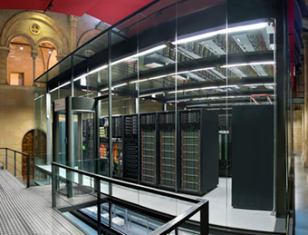
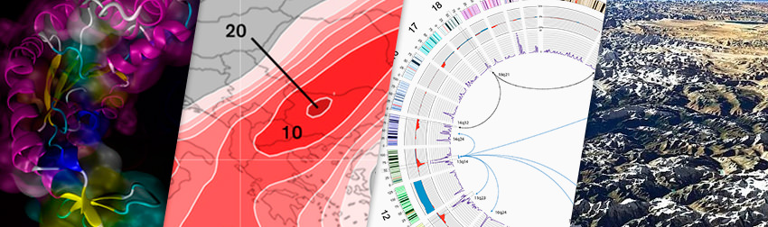




Barcelona Supercomputing Center
Centro Nacional de Supercomputación
Supercomputing services
to Spanish and
EU researchers
R&D in Computer,
Life, Earth and
Engineering Sciences
PhD programme,
technology transfer,
public engagement
Spanish Government 60%
Catalonian Government 30%
Univ. Politècnica de Catalunya (UPC) 10%
BSC-CNS is
a consortium
that includes

Slide 3
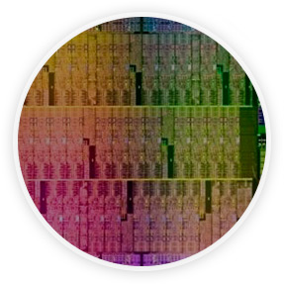


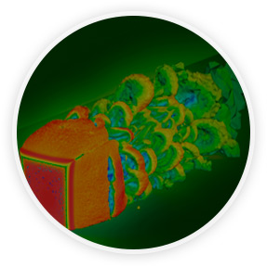
Mission of BSC Scientific Departments
Computer
Sciences
Earth Sciences
To influence the way machines are built, programmed and used: programming models, performance tools, Big Data, computer architecture, energy efficiency
To develop and implement global and regional state-of-the-art models for short-term air quality forecast and long-term climate applications
Life
Sciences
CASE
To understand living organisms by means of theoretical and computational methods (molecular modeling, genomics, proteomics)
To develop scientific and engineering software to efficiently exploit super-computing capabilities (biomedical, geophysics, atmospheric, energy, social and economic simulations)

Slide 4
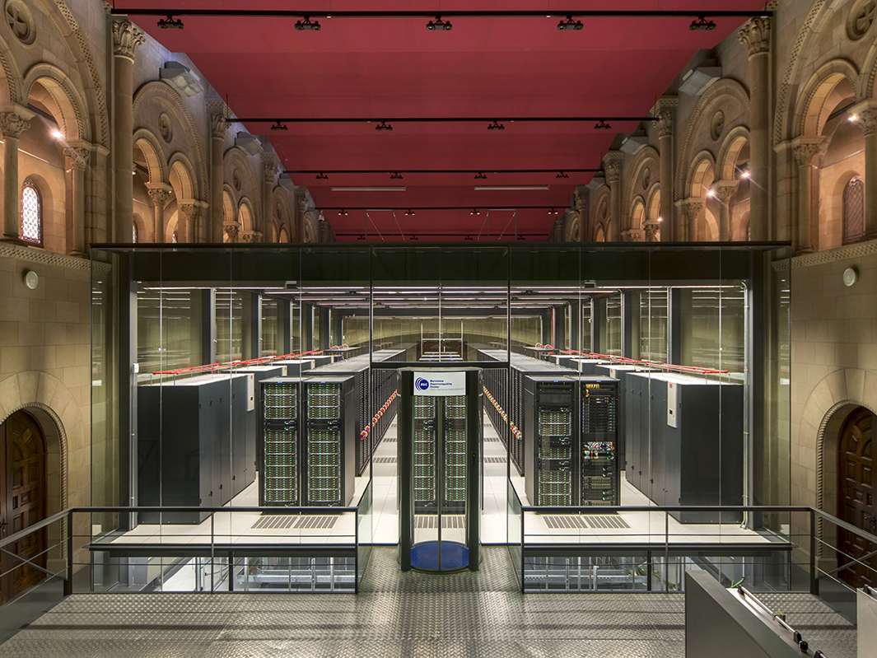


Slide 5
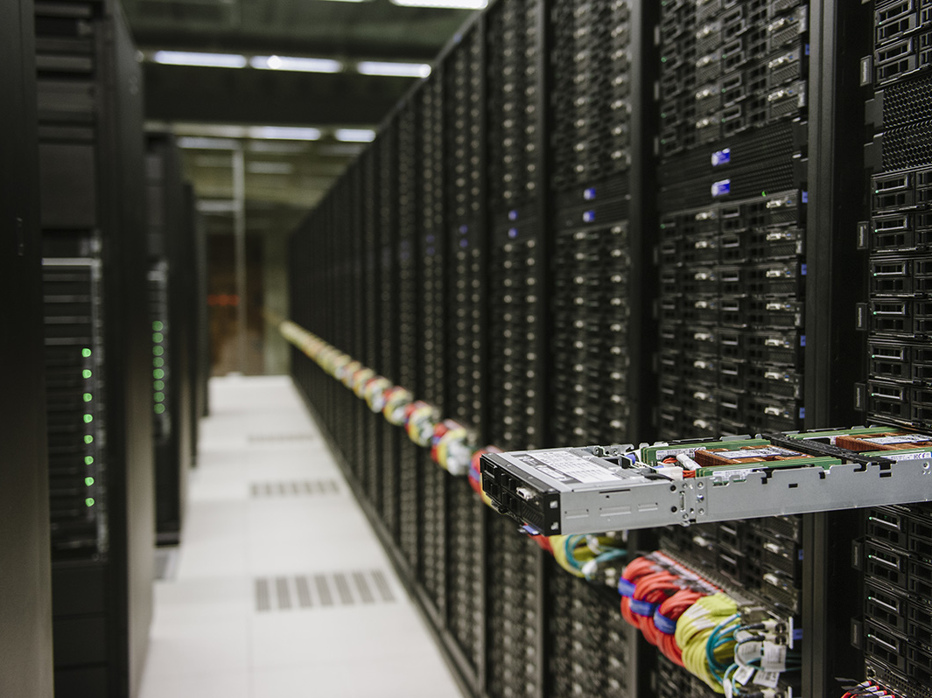
General Purpose
for current BSC workload
11.15 Pflops/s
3,456 nodes of Intel Xeon Platinum processors
390 Terabytes of Main Memory
14PB storage

Slide 6
MareNostrum4
Total peak performance: 13,7 Pflops/s
12 times more powerful than MareNostrum 3
80%
16%
4%
Access: prace-ri.eu/hpc_acces
Access: bsc.es/res-intranet

Slide 7


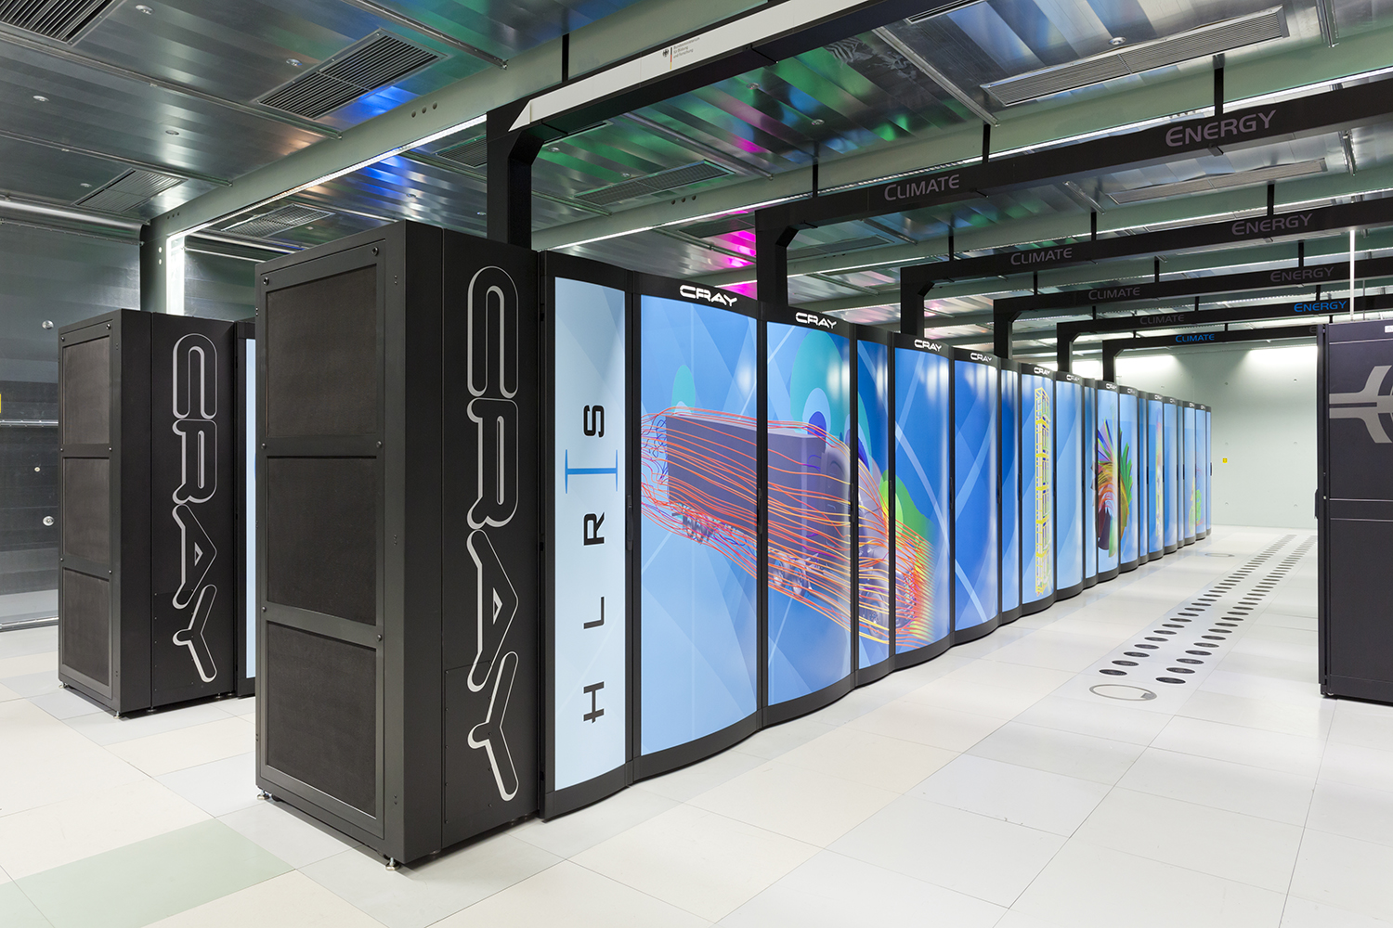

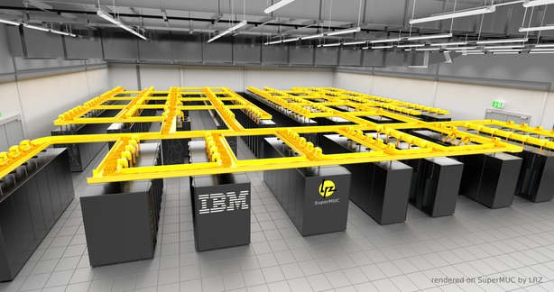

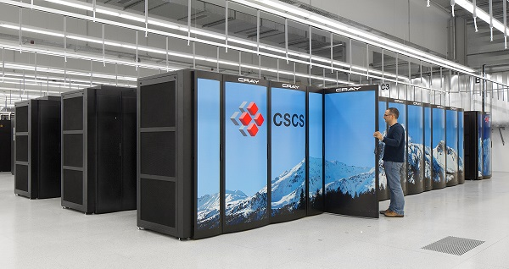
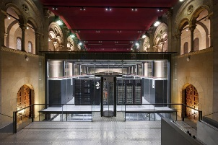
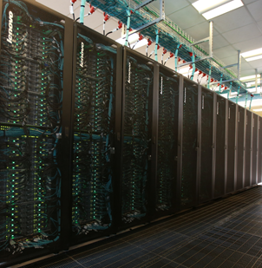
Distributed Supercomputing Infrastructure
24 members, including
5 Hosting Members
(Switzerland, France, Germany, Italy and Spain)
Hazel Hen
JUQUEEN
SuperMUC
524 scientific projects enabled
Curie
70 PFlops/s of peak performance on 7 world-class systems
Piz Daint
>10.000 people trained by 6 PRACE Advanced Training Centers and others events
MareNostrum
Marconi
Access
prace-ri.eu/hpc_acces

Slide 8

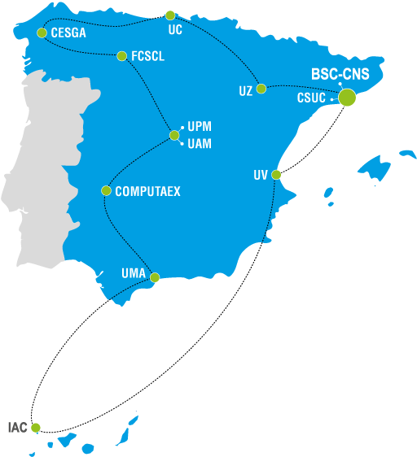
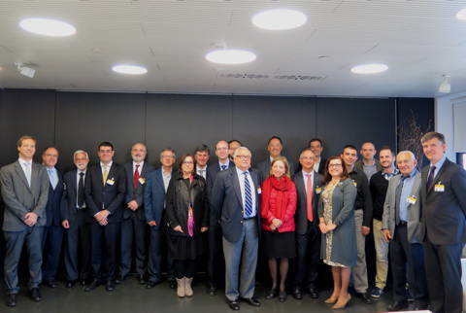











Red Española de Supercomputación
RES now made up of thirteen supercomputers
Finis Terrae II, Centro de Supercomputación de Galicia (CESGA)
Pirineus, Consorcio de Servicios Universitarios de Cataluña (CSUC)
Lusitania, Fundación Computación y Tecnologías Avanzadas de Extremadura
Caléndula, Centro de Supercomputación de Castilla y León
Cibeles, Universidad Autónoma de Madrid
Access
bsc.es/res-intranet

Slide 9

BSC infrastructure roadmap
2016
2017
2018
2019
2020
2021
Compute
MN3, 1.1 PFlops
Intel SB + Intel KNC, IB FDR10
MN4, >13.7 PFlops
General Purpose: 11.15 Pflops, Intel SKL+OPA
Emerging Technologies: P9+Volta (1.6PF), ARM (0.5PF), ‘KNH’ (0.5PF)
MN5, pre-exascale
MT2, 183 TFlops
NVIDIA 252xM2090
MT1.5
MT2, 339 TFlops
NVIDIA 78xK80 + 122xM2090
Data Analytics Cluster
Cluster services for industry including SMEs
Cluster BSC-CRG-IRB
Storage
GPFS 2PB
15 GB/s
GPFS 3PB
37 GB/s
GPFS 15PB
130 GB/s
GPFS 20-40 PB
500 – 1000 GB/s
Long term storage
Active Archive, 6 PB
HSM, 100 PB
90% on tape
Backup, 6 PB
Backup, 10 PB
Backup, 20-40 PB
CPD
CPD Capella, MN3
CPD Capella, MN4
CPD Capella (4 MW)
New CPD (20MW)
Network, 10Gbps
Network, 2x10Gbps
Network, 4x10Gbps

Slide 10
Thank you
sergi.girona@bsc.es
07/05/2018

