Slide 1
OmniAccess® Stellar: la plataforma WLAN para IoT y SmartCampus
Jorge Arasanz (jorge.arasanz@al-enterprise.com)

Slide 2
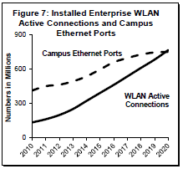
2.5/5G Ethernet Adoption
Ports shipment for Fixed Ports
Source: DellO’ro 5 yr Ethernet Switch Forecast , Jan 2016
2.5/5G counted as part of 10G by analysts.
As per DellO’ro by 2020, more than 50% of overall 10G revenue will be from multi-gigabit in the campus
By 2020, number of Enterprise class WLAN infrastructure users will exceed that of Campus users.
Combined with 802.11ac wave2 adoption, this will drive a much faster adoption of multi gig on Ethernet switches
Source: Dell O’ro 5 yr WLAN Forecast , Jan 2016
Notes:
Custom built switches for supporting WLAN APs

Slide 3
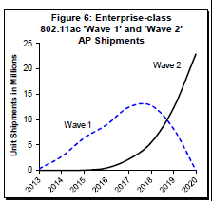
802.11ac wave 2 Adoption
The enterprise/campus market has started a mini-upgrade cycle to 2.5/5.0 GE. 802.11ac Wave 2 shipments start ramping up in 2016
802.11ac AP shipments already surpassed the 802.11n shipments in 2015 although majority of these were 802.11ac wave 1 shipments
Current PHY rates on 802.11ac wave 2 with 4x4 MU:MIMO are 1.6 Gbps.
Shipment of Wave 2 Access points will exceed Wave 1 shipments by 2019.
Source: Dell O’ro WLAN 5 year forecast, Jan 2016
Enterprise AP Shipment Volume Split
Source: Dell O’ro WLAN 5 year forecast, Jan 2016

Slide 4
802.11 an endless evolution
GHz/bps
60/100G
802.11ay (ad successor)
5-2,4/10G
802.11ax (ac successor)
60/6,7G
802.11ad (WiGig vs WirelessHD/UltraGig)
5/3,4G
802.11ac-W2
5/1,3G
802.11ac-W1
5-2,4/150M
802.11n
5-2,4/54M
802.11a
802.11g
<1/347M
802.11af
802.11ah - IoT WLAN
1999
2003
2009
2012
2013
2014
2015
2016
2018
2019
t

Slide 5
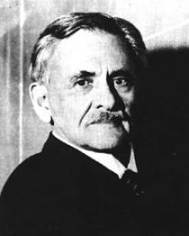

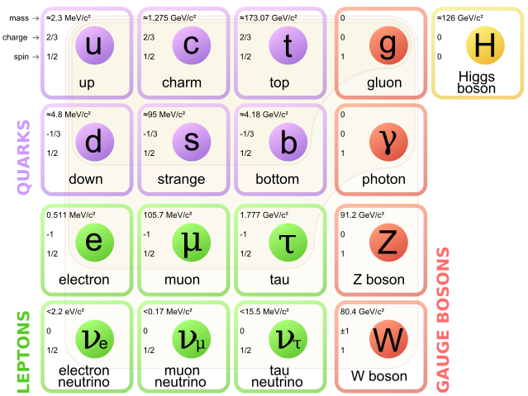
Sometimes all what is known, have to be changed…
“While it is never safe to affirm that the future of Physical Science has no marvels in store even more astonishing than those of the past, it seems probable that most of the grand underlying principles have been firmly established and that further advances are to be sought chiefly in the rigorous application of these principles to all the phenomena which come under our notice.” (1894)
Albert Abraham Michelson
Notes:
Albert Abraham Michelson, the FIRST American to receive the Nobel Prize in Physics.
In 1894, said in a conference, that “almost all physics principles have been discovered, but two small things that will be close in short term”.
Those “two small things” were:
Michelson-Morley experiment (1887)… Its own experiment about the movement of the Earth relative to aether, conducted to the MAX speed of light… that later conducted to General Relativity of Albert Einstein
Black-body radiation (1890)… leaded to one of the most important revolutions in human history: The Quantum Theory and the Standard Model.
That “two small things” CHANGED FOREVER OUR VIEW OF THE UNIVERSE…
Evolution NEEDs Change, and sometimes change all wha have been known till now…

Slide 6
Changing the paradigm to avoid the meltdown
100s of APs at 2,5/5/10Gbps, impose 100/400Gbps interfaces at Central Traffic Points
100s of clients per AP (IoT), impose massive CPU power for Traffic Control at
Central Traffic Points
100s of users per AP, impose costly CryptoModules at
Central Traffic Points
Central Traffic Points (Controllers)
WILL BE ABLE TO SCALE
NOT

Slide 7

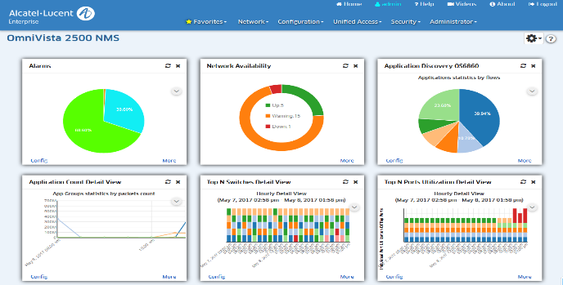
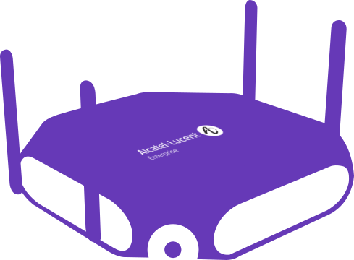



OmniAccess® Stellar WLAN
OmniVista 2500
Centralized & Integrated MANAGEMENT
  LAN & WLAN Unified Management
  L7 App Analytics (LAN & WLAN)
  WIPS
  GUEST Management
  Authentication Server
  BYOD Management
ONE SINGLE POINT OF MANAGEMENT
Cloud Ready (Enterprise or Cloud)
Distributed Intelligence
Distributed Control:
  AP coordination
  DRM: Distributed RF Management
  L2/L3 Roaming
  Distributed User profile
Distributed Forwarding

Slide 8
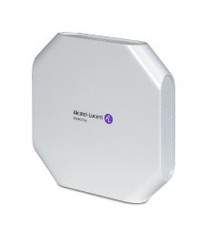
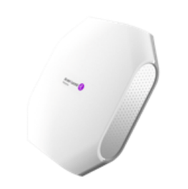
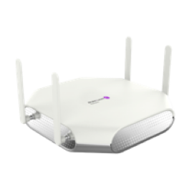
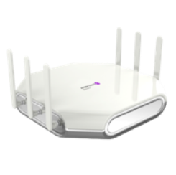
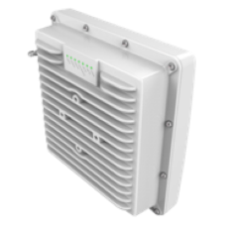

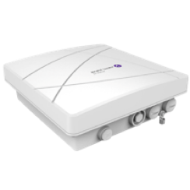
OmniAccess® Stellar Access Points Lineup
AP1101
802.11ac: Wave 1
2 radios
2x2:2SS
1.2 Gbps throughput
No BLE
1 GE port
128 client devices per AP
10 W (802.3af PoE or DC)
Operating Temp: 0°C to 45°C
AP1221/AP1222
802.11ac Wave 2
2 radios
2×2:2 @ 2.4GHz, 4x4:4 @ 5GHz
2.2+ Gbps throughput
Optional USB BLE radio dongle
1 GE Port
512 client devices per AP
<24W (802.3at 2pair PoE or DC)
Operating Temp: 0°C to 45°C
AP1231/AP1232
802.11ac Wave 2
3 radios
4×4:4 @ 2.4GHz, dual 4x4:4 @ 5GHz
4.2+ Gbps throughput
Integrated BLE radio
1xGbE + 1x2.5GbE network interfaces
768 client devices per AP
36W (802.3at 4pair or DC)
Operating Temp: 0°C to 40°C
AP1251
802.11ac Wave 2
2 radios
2×2:2 @ 2.4GHz, 2x2:2 @ 5GHz
1.2 Gbps throughput
No BLE
2xGbE network interfaces
512 client devices per AP
<12W (802.3af PoE)
Operating temperature : -40 to 65°C

Slide 9
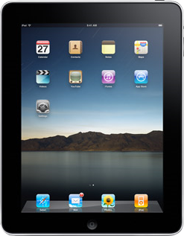













ADDING Application visibility & enforcement over the air!
Business critical
Other business apps + personal apps
Non-compliant apps
L7 Apps UNIFIED Analytics for
LAN and WLAN
Notes:
Our unified access strategy also includes network services to help manage the applications. Our latest application analytics capability provides the network with the intelligence to recognize the applications traversing the network and also control them via a set of predefined policies. With this capability, IT can prioritize business critical applications and reserves bandwidth to make sure they can be delivered with the quality necessary. It is also possible to prevent harmful or non-compliant applications from being utilized and also create a space for employees to explore new applications and also use personal apps, harmonizing the coexistence of both business and personal applications. The granular level of application visibility is achieved with out high end switches that use DPI techniques to identify applications and enforce policies at wire rate right at the edge of the network.
As many applications go through the process of webification, networks without analytics will see all the traffic as HTTP. It all look alike and will be treated in the same way. However with application analytics it is possible to identify each application encapsulated under an HTTP interface and therefore apply different prioritization and QOS to critical applications like Salesforce, SAP, Rainbow and IP telephony against some personal apps like Facebook, YouTube etc.

Slide 10

UNP: Continuos IoT secured networks in LAN and WLAN.
OS6560
OS6560
OS6450
OS6560
OS6860E
OV2500
UNP - Universal Network Profile
OS6900

Slide 11
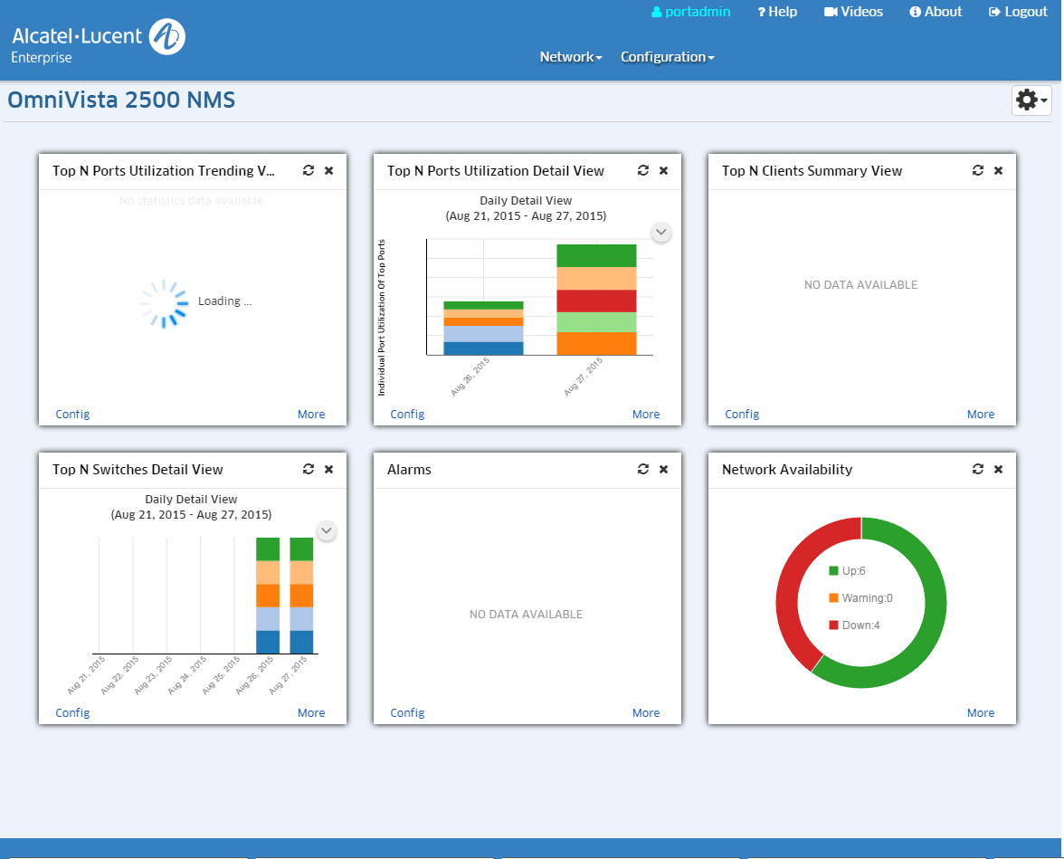
OV2500 UPAM – Unified Policy Authentication Manager
Guest Access, BYOD, IT Owned
Enterprise: External Radius (Eduroam), Local DB, External AD/LDAP
Wired/Wireless
Authentication
Access
Guest
Management
Account Creation, Notification (SMS, Email, WEB)
Self-Registration, Employee Sponsor
Basic/ Premium Servicing
Login using: Uname/Passwd, Access-Code, Social Account
UPAM
BYOD
Session & Device Control
Device Fingerprinting (OS, Type, etc.)
Portal
Customizable Pages: Guest Access/ BYOD
Success Redirect URL

Slide 12
DRM – Over the Air
Only for RF & Stellar Neighbor Discovery:
IP address, Name, OV2500
AP-Group-2
AP-5
AP-2
AP-8
AP-6
AP-1
AP-7
AP-Group-3
AP-4
AP-3
AP-9
AP-Group-1
AP-1 Coverage

Slide 13
Dynamic Load Balance – Client LOAD Sharing
Device | Clients
AP1 | 10
AP2 | 8
AP3 | 15
Device | Clients
AP1 | 10
AP2 | 8
AP3 | 15
New Client
1 Broadcast Join Request
1 Broadcast Join Request
AP
2 Reply to Client
1 Broadcast Join Request
Every AP learns the neighboring information through Neighbor Management Protocol
When a new client appears, Each AP will set up a timer based on its connecting clients
When the timer ends, AP will respond to the new client
The new client is guided to connect to the lightest loaded AP
Device | Clients
AP1 | 10
AP2 | 8
AP3 | 15

Slide 14
Client Roaming
Network
OmniVista
Access Role Profile Vlan Mapping
- AP GROUP 1: Employee = 2001
- AP GROUP 2: Employee = 2002
VLAN 2001
VLAN 2002
AP GROUP 1
Client
MAC
Client
MAC
Client
MAC
AP GROUP 2
DEL
DEL
DEL
CTX
CTX
CTX
CTX
CTX
CTX
CTX
CTX
CTX
Context
Context
Context
Initial Association
WLAN Service/SSID: Employee
Access Role Profile: Employee
Vlan mapping : 2001
2nd L2 Roam
WLAN Service/SSID: Employee
Access Role Profile: Employee
Vlan mapping : 2001
1st L2 Roam
WLAN Service/SSID: Employee
Access Role Profile: Employee
Vlan mapping : 2001
L3 Roaming!
Employee vlan = 2002
Client Context clean up

Slide 15
Key Takeaways
A single platform to manage Access Network, on premises or Cloud
A single platform to manage all Authentication needs (Employees, Guest, CP, …)
Distributed Control and Forwarding. Centralized Management.

Slide 16
enterprise.alcatel-lucent.com
facebook.com/ALUEnterprise
linkedin.com/company/alcatellucententerprise
twitter.com/ALUEnterprise
youtube.com/user/enterpriseALU

