Slide 1
Intelligent Transport Network
Manuel Morales
Technical Director Infinera

Slide 2

The Foundations of Intelligent Transport
Monetize Networks
Increase Efficiencies
Accelerate services
Expand revenue
Protect Investments
Lower capex, opex
Convergence
Innovation
Scalability
Automation
An Infinite Pool of Intelligent Bandwidth
For The Terabit Era
Notes:
To sum up, the Infinera Intelligent Transport Network is built on the foundation of convergence, scalability and automation for the next decade. It is designed to help service providers address both side of the money equation- make money and save money.
Ultimately helping providers create an infinite pool of intelligent bandwidth for the Terabit Era.

Slide 3
Scale

Slide 4
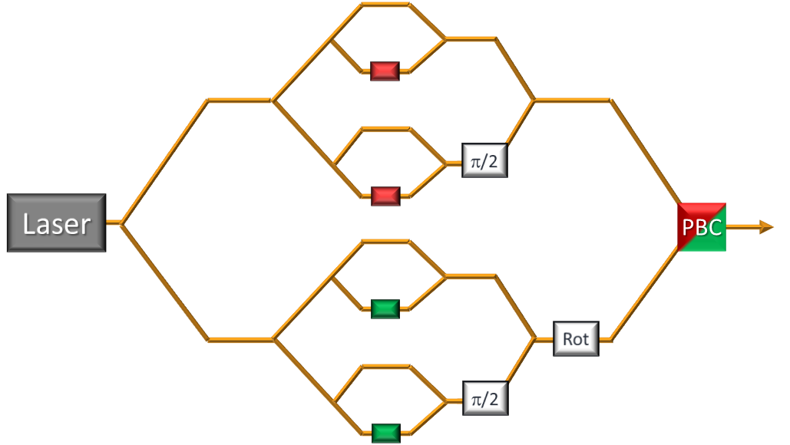
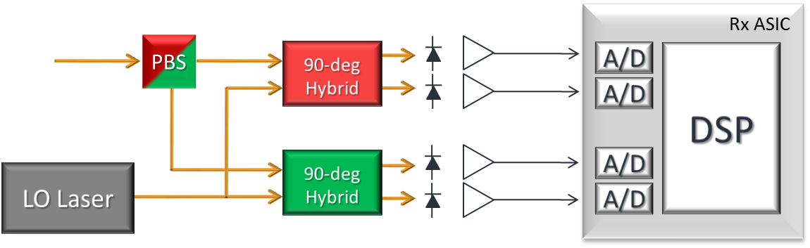
The “miracle” of coherent transmission
10Gb/s per channel
80 channels = 800Gb/s
100Gb/s per channel
80 channels = 8Tb/s
A simple transmitter, and even simpler detector with no significant signal processing
A complex transmitter, and even more complex detector with very significant signal processing
Laser
Modulator
Photodetector

Slide 5
Moving to multi-carrier super-channels
Single Carrier
Dual Carrier
Ten Carrier
500Gb/s
SC-PM-QPSK
500Gb/s
DC-PM-QPSK
500Gb/s
10C-PM-QPSK
190 GHz
190 GHz
190 GHz
1 Laser
4 modulators
160 Gbaud Electronics
Time to Market: ~7 years
2 Lasers
8 modulators
80 Gbaud Electronics
Time to Market: ~5 years
10 Lasers
40 Modulators
16 GBaud electronics
Time to Market: NOW
Must be spectrally efficient, and possible to manufacture

Slide 6
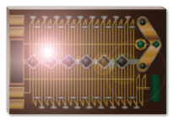
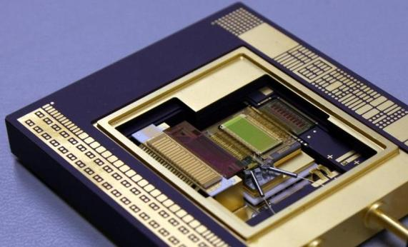
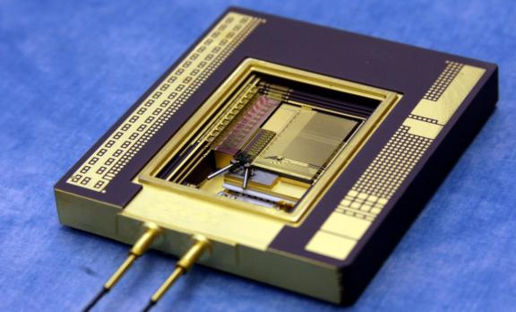
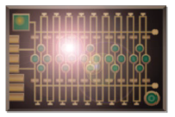
Controlling the “Component Explosion”:
The Power of Large Scale PICs
Coherent Super-Channel Tx circuit is complex
Coherent Super-Channel Rx circuit is even more complex
Unless…
Optical Functions Integrated
>600
Fiber Connections Eliminated
~250

Slide 7

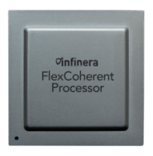






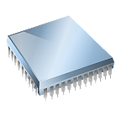



PICs Deliver Massive Capacity:
With Lower Power and Space
Coherent
(Electronics)
Optical
(Photonics)
500G Module Example
FlexCoherent™
Processor (FCP)
3rd Gen 500G PIC
.78W / Gbs
SUPER MZ
SUPER MZ
SUPER MZ
Conventional
Solution
SUPER MZ
SUPER MZ
SUPER MZ
Coherent ASIC
SUPER MZ
SUPER MZ
2.8 W / Gbps
3rd party optics
Infinera est. for currently avail. product operating at 25°C
Notes:
Let’s take a look at what it takes to build a DWDM line card. As I mentioned before, there are two fundamental elements required to build a 100G capable DWDM line card
Coherent processing which are “the electronics”
And the lasers, multiplexors and modulators which are “the optics”
If we look at Coherent processing first, to build a 100G card Infinera would use one of our FlexCoherent Processor chips. These chips are shipping today, delivering the worlds first FlexCoherent capabilities.
Our competitors would have to do the same – for example one WaveLogic processor for 100G. Basically every vendor who is entering the 100G market in earnest has some sort of coherent development – you name it, Ciena, Alactel-Lucent, Huawei, NSN, etc.
<click>
Next is the optics. Here is where Infinera breaks away from the pack. We are able to integrate over 600 functions, 100 gold boxes and 250 fiber connections into our 3rd generation 500G PIC which is the size of my fingernail.
The competitors use off the shelf components, all of those 600 functions, 100 gold boxes and 250 fiber connections I mentioned to build their optical engine.
The result?
<click>
We can achieve densities for our optical line cards that no other vendor can touch. We can put 500G in a single line card that uses about 3/4s of a watt per gigabit per second.
For the competition to match our 500G of capacity it will take them 5 lines cards which in their machines today typically takes 10 or 15 slots and in one competitive analysis 2.8 watts per Gig!
So what does this mean – we can provide much higher density WDM which results in less space, power, heat and cooling…which in turn provides us the headroom to integrate high capacity non-blocking switching into our system…to deliver a truly converged platform without compromise
<click?

Slide 8
Scaling with FlexCoherent Super-Channels
Software Selectable Ability to optimize reach vs. capacity on a given link
  Per super-channel modulation format control
6000
3000
PM-QPSK
PM-8QAM
1500
700
PM-BPSK
PM-16QAM
Reach
Capacity
Infinera: Leading the way forward in coherent technology
Notes:
Often scale is traded off with reach
Adding reach flexibility to scale capacity helps alleviate this trade-off
Customers get this via Infinera’s FlexCoherent technology that optimizes reach vs. capacity

Slide 9
Converge

Slide 10
Service Mix vs DWDM Line Rate
Service Mix
DWDM Line Rate
100GbE
10GbE
1GbE
Line
Card
FlexCoherent
500G and 1T Super-Channels
Mainly GbE and 10GbE

Slide 11
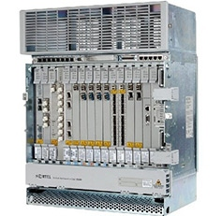
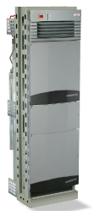
One Practical Issue of Separate Platforms
100G wave with
5 x 10G services
40 %
Efficiently filled 100G wave
Fiber
direction #2
50%
90%
100G wave with
4 x 10G services
Fiber
direction #1
Fiber
direction #3
Multiple 10G transponders
Design complexity
Cabling nightmare!
CapEx penalty of stand-alone switches
OpEx penalty of extra space/power
Example is for single 100G wave: Imagine 80x more!

Slide 12
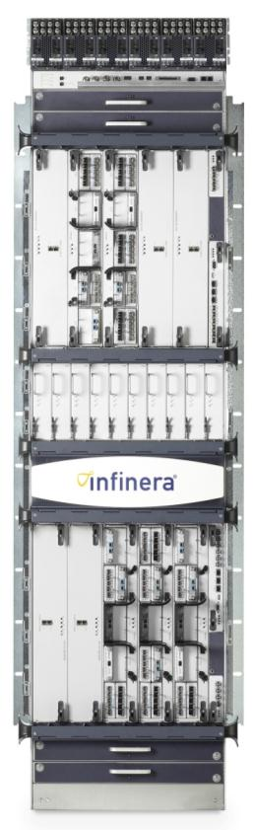
Why is Integrated Switch + WDM Better?
100G wave with
5 x 10G services
40 %
Efficiently filled 100G wave
Fiber
direction #2
50%
90%
100G wave with
4 x 10G services
Fiber
direction #1
Fiber
direction #3
W
Eliminate Interconnects
Reduce
Space/Power
Eliminate Separate Switch
Automate Connections
CapEx & OpEx savings from integrated Switch + WDM

Slide 13
Automate

Slide 14
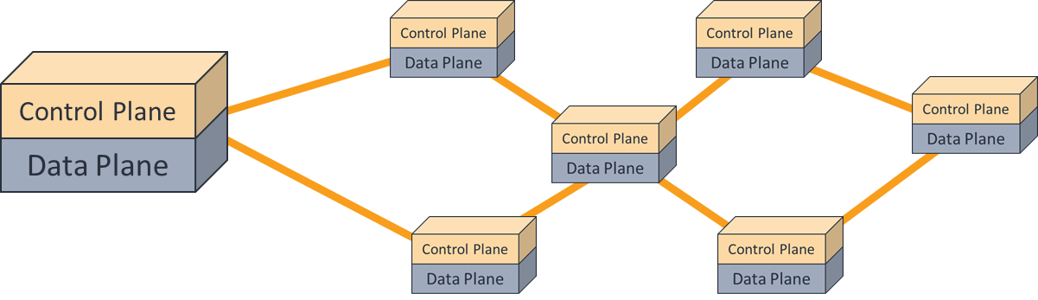
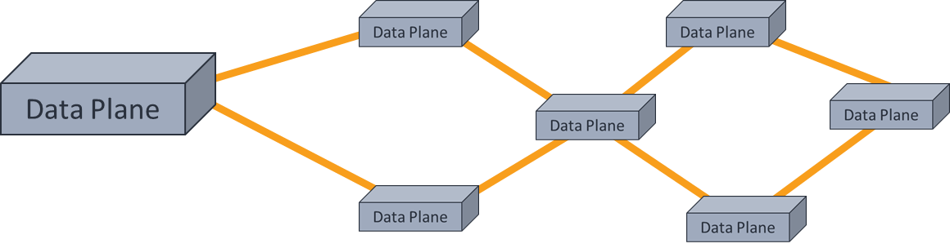
What is SDN?
“Today”
Distributed: GMPLS
Controller
“Today”
Centralized: SDN

Slide 15
What Control Planes need from an optical transport network
The ability to control network resources and properties at a distance
Service
Ready
Capacity
Intelligent Transport Network
Digital
Network
Operation
✓
✓
☒
These characteristic are absent from traditional optical networks

Slide 16
Use Case: Multi-Layer Optimization and Provisioning
“SDN is not a technology, it’s a use case”
Greg Ferro, Network Computing
Service Provider A
Use Case #1
End to end service provisioning
Within a single service provider
“Vertically” through multiple network technologies, and multiple vendors
SDN advantages vs Distributed:
  Controller can have full topological visibility across all layers
  Opportunity for superior Planning and Traffic Engineering
IP
MPLS
Converged OTN/DWDM

Slide 17
Use Case: Multi-Domain Provisioning
“SDN is not a technology, it’s a use case”
Greg Ferro, Network Computing
Service Provider A
Service Provider B
Use Case #2
End to end service provisioning
Between service providers
Can be “horizontal only”
Could be “vertical” also
SDN Advantages vs Distributed:
  Internal detailed topology can be hidden between domains
  Can combine with vertical provisioning within domain
IP
IP
MPLS
MPLS
Converged
OTN/DWDM
Converged
OTN/DWDM

Slide 18
The Story of a Guinness World Record

Slide 19
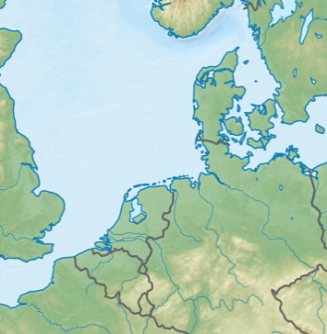
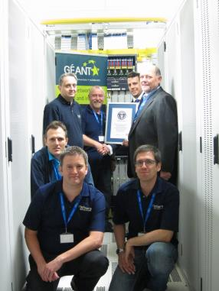


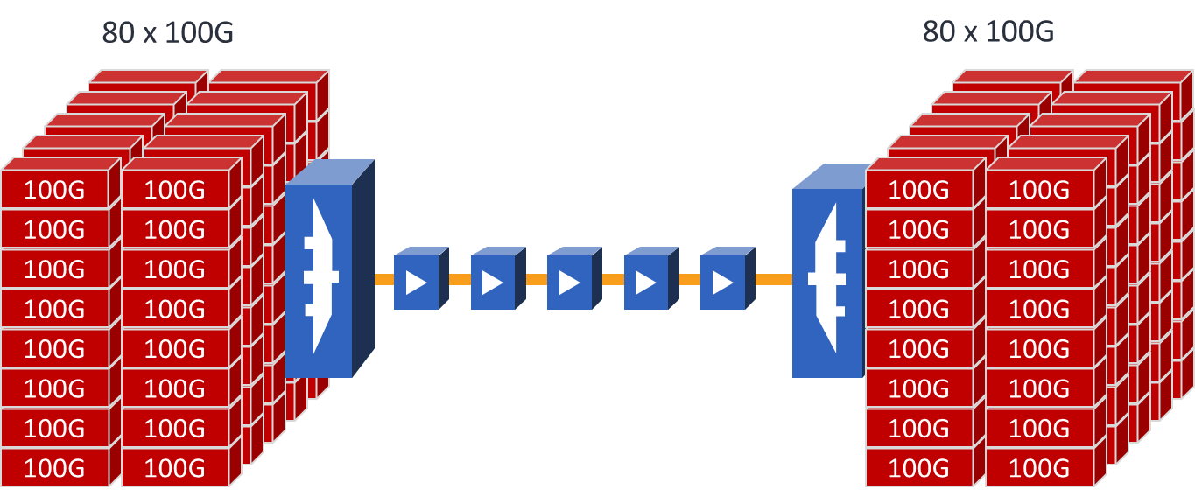
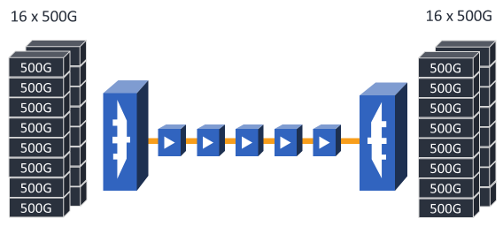
August 13, 2013
Super-Channel Guinness World Record
Amsterdam to Hamburg (real network link)
8Tb/s in 19min w/1 engineer
Production equipment, production link
Equivalent of entire internet in 2005
Proves lower OpEx and Time as a Weapon
Only 1 company is shipping super-channels
Hamburg
Amsterdam
Conventional 100G
160 transponders, 160 fibers
Infinera Super-Channels
32 Line Modules, 32 Fibers
Notes:
On August 13th, 2013 a team from Infinera and DANTE established an official Guinness World Record for the fastest provisioning of multi-terabit capacity on a long haul network.
CLICK
The link was part of the GEANT backbone, operated by DANTE, and it runs between Amsterdam in the Netherlands and Hamburg in Germany.
CLICK
We achieved 8Tb/s of super-channel capacity turned up in just over 19 minutes, and with only one engineer touching the equipment.
CLICK
Just to be clear. This was not a hero experiment. It used production equipment, over a real network link and amp chain. And the scale of the capacity is the equivalent to the entire global internet in 2005.
CLICK
A key point to this record attempt is that it is a clear proof point for Infinera’s Intelligent Transport Network architecture, and showcases our ability to drive down network OpEx and allow our customers to use Time as a Weapon.
CLICK
Here’s a simple summary of why that’s the case. In a conventional 100G, transponder-based deployment a service provider would need to deploy 160 transponders, and connect 160 fibers into the line system to achieve 8Tb/s of capacity. It could be done…but goodness knows how long it would take. Depending on the exact system used it might take a considerable amount of time to balance the power of the amplifiers along the link.
CLICK
But with the Infinera Super-Channel approach we only needed 32 line modules – 16 at each end of the link, and only 32 cables connecting those line modules to the line system. All the amplifier power balancing was performed automatically by protocols within the Infinera equipment.
CLICK
That kind of operational scalability is unique to the Infinera solution because we are the only company shipping super-channels today.

Slide 20
Summary
Coherent super-channels are the key to scalability and spectral efficiency
  Photonic Integrated Circuits are the ideal approach
Service mix and DWDM line rate highly mis-matched
  Converged OTN switching is essential to maintain network efficiency
Modern control planes, require specific properties of the underlying data plane
  True for distributed GMPLS and centralized SDN
  Requirements are: Service Ready Capacity & Deterministic Switching

