Slide 1

The Evolution of the Data Center
Albert Puig Artola
apuig@aristanetworks.com

Slide 2

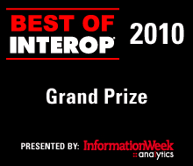
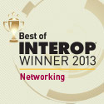
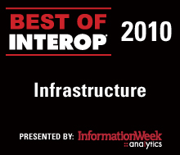


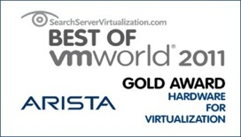
Arista Networks – Corporate Overview
Software Designed Cloud Networking
Founded in 2004
> 2000 clients of all sizes
> 600 employees
Profitable, self-financed, pre-IPO
A generation ahead in software architecture
Jayshree Ullal
Andy Bechtolsheim
President & CEO
Chairman & CDO

Slide 3
Data Center Transport

Slide 4
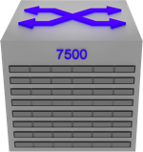

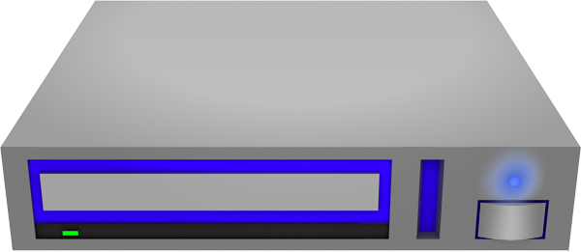
Data Centre Transport
For the East to West Traffic workflows
Agreement on the Physical topology
Physical Architecture CLOS Leaf/Spine
Consistent any-to-any latency/throughput
Consistent performance for all racks
Fully non-block architecture if required
Simple scaling of new racks
Spine Layer
10Gbe/40Gbe
Layer 2/3
Leaf layer
10Gbe/1Gbe
Layer 2/3
Consistent performance, subscription and latency between all racks
Consistent performance and latency with scale
Architecture built for any-to-any Data center traffic workflows

Slide 5
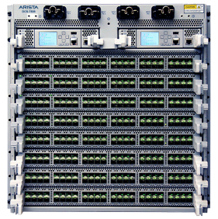
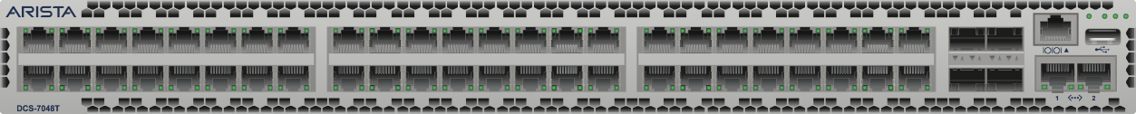
Data Centre Transport
Active-active L2 topologies possible without new protocols
MLAG, uses known and trusted standard LACP protocol.
Achieved without new hardware or any new operational challenges
But at large scale same challenges as the new protocols, VLANs and MAC explosion
Layer 2 can scale to a level without requiring new protocols and hardware
Layer 2 Leaf-Spine – MLAG Design
The layer 2 approach only targets the VMobility challenge, what about Scale,
Multi-tenancy, Simplicity and Big Data environments

Slide 6
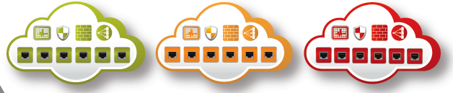


Data Centre Transport
To provide scale evolution is to decouple the virtualized network from the physical infrastructure
Remove the scaling and architecture requirements from the physical infrastructure
Architecture of the physical infrastructure not tied to the virtual infrastructure
Building a physical transport infrastructure for bandwidth, port scale and operation
Allowing the standardize of the the networking platform regardless of the application
Cloud Network
Big Data
Web 2.0
Virtualized
Solution
Single scalable
Physical
Infrastructure

Slide 7

Data Centre Transport
Building the Layer 3 network
For scale and East to West traffic growth
Physical CLOS leaf/Spine architecture
Standard routing Protocols between the leaf and Spine (OSPF/BGP)
Equal Cost Multi-Pathing (ECMP) for active-active forwarding
Standard protocols and Standard hardware,
No increase in management or operational cost, minimal risk
Increased Resilience
All links are active, and forwarding traffic
Distributed failure domain, with multiple spine topology
Physically Distributed resilient Core
1U or chassis
L3 switch
OSPF or
BGP
Layer 3
between
Leaf and Spine
ECMP
ECMP
L2/L3 switch
Layer 2
within
the Rack
Subnet-D
Subnet-E
Subnet-A
Subnet-F
Subnet-B
Subnet-C
Scaling a Layer 3 network for East to West traffic

Slide 8
Data Centre Transport
The Layer 3 ECMP approach for the IP Transport
Provides horizontal scale for the growth in East-to-West Traffic
Provides the port density scale using tried and well-known protocols and management tools
Doesn’t require an upheaval in infrastructure or operational costs.
Removes VLAN scaling issues, controls broadcast and fault domains
Overlay Networks are the solution to v-mobility problem
Abstract the virtual environment form the physical environment
Layer 3 physical infrastructure for transport/BW between leaf and Spine nodes
Overlay network virtualizes the connectivity between the end nodes
Minimize the operational and scale challenges from the IP Fabric Core

Slide 9
Software is the Key for SDN

Slide 10
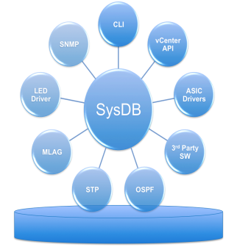
Introducing EOS - the Extensible Operating System
Unique EOS SysDB
Decouples protocol state from processing increasing reliability
Database for IPC
Stateless model reduces complexity and improves performance
Live Patching
Avoid costly downtime for critical security fixes
Linux Kernel
Open to flexible automation using Linux toolsets and scripts
EOS APIs
Network wide automation of operations and provisioning systems
Linux Kernel
Leading the next wave of Networking: Software Defined Cloud Networking

Slide 11
EOS – Extensible Operating System
sysDB
CLI
vSwitch Mgmt
OSPF
STP
LAG
XML/ SOAP
SNMP
ASIC Drivers
3rd Party SW
Fully modular, multi-process, multi-threaded, stateful restart
Core sysdb for all session state and inter-process communications
In-service-software-upgrades
Extensible architecture enables 3rd party applications
Focused on making operations simpler
One system image for all product families
Protected OS Kernel

Slide 12
Overlay Networks

Slide 13
Overlay Network
What is an Overlay Network
Abstracts the virtualized environment form the physical topology
Constructs L2 tunnels across the physical infrastructure
Tunnels provide connectivity between physical and virtual end-points
Physical Infrastructure
Transparent to the overlay technology
Allows the building of L3 infrastructure
Physical provide the bandwidth and scale for the communication
Removes the scaling constraints of the physical from the virtual
Logical tunnels across
the physical Infrastructure
Overlay
network
Physical
Infrastructure

Slide 14
Overlay Network
IP Overlay
Virtual eXtensible LAN (VXLAN)
IETF framework proposal, co-authored by Arista, Vmware, Cisco, Citrix, Red hat and Broadcom
Vmotion across L3 boundaries
Transparent to the physical IP fabric
Provides Layer 2 scale across the Layer 3 IP fabric
Abstracts the Virtual connectivity from the physical IP infrastruture
Subnet A
Subnet B
ESX host
ESX host
VM mobility
Across Layer 3 subnets
VM-1
10.10.10.1/24
VM-3
10.10.10.2/24
VM-4
20.20.20.1/24
VM-2
20.20.20.1/24
Subnet A

Slide 15


Overlay Network
With a Layer 2 only Service the Tenant Networks are abstracted from the IP Fabric, SP cloud model
Spine1 routing table
10.10.10.0/24 → ToR1
Hardware VTEP announce
only the loopback in OSPF
10.10.20.0/24 → ToR2
10.10.30.1/32 → ToR3
10.10.40.1/32 → ToR4
Default Gateway for
Physical servers
ECMP
VTEP
10.10.30.1/32
VTEP
VTEP
10.10.40.1
VTEP
Subnet
10.10.10.0/24
Subnet
10.10.20.0/24
VTEP
10.10.10.1
VTEP
VTEP
10.10.20.1
VTEP
VLAN 200
192.168.20.7
VLAN 100
192.168.10.6
VRF-1
VRF-2
Tenant DGW
Tenant DGW
VLAN 10
192.168.10.9
VLAN translation on VTEP
VLAN 10
192.168.10.4
VLAN 10
192.168.10.5
VLAN 20
192.168.20.4
VLAN 20
192.168.20.5
VLAN 20
192.168.20.6
VLAN 10
192.168.10.6
Physical Server
(Bare Metal Server)
Virtual Servers
Virtual Servers
VNI-100
VNI-200
VNI-200
VNI-300

Slide 16
Overlay Network
Overlay Network provides transparency
Scalable Layer 2 services across a layer 3 transport
Decouples the requirements of the Virtualized from the constraints of the physical network
Tenant network transparent to the transport for Layer 3 scale
Multi-Tenancy with 24-bit tenancy ID and overlapping VLANs
Network becomes a flexible bandwidth platform
VNI 3000
VNI 3000
VNI 2000
Overlay
network
Transparent
L2 Services
Physical
Infrastructure
Layer 3
Transport
Scalable, multi-tenant Layer 2 services transparent to the Layer 3 transport network

Slide 17
Telemetry

Slide 18









Arista Network Telemetry - Application Infrastructure
Link infrastructure and application
Critical real-time information enabling network aware applications
Gain Precision Visibility
Utilize differentiated tools
Close partnerships deliver best of breed solutions
Proactively detect issues
React to coordinate actions or take direction from other applications / infrastructure
Notify other elements or operations team of changing conditions
Monitoring
Discrete
VMware NSX
Storage
Bare Metal

Slide 19
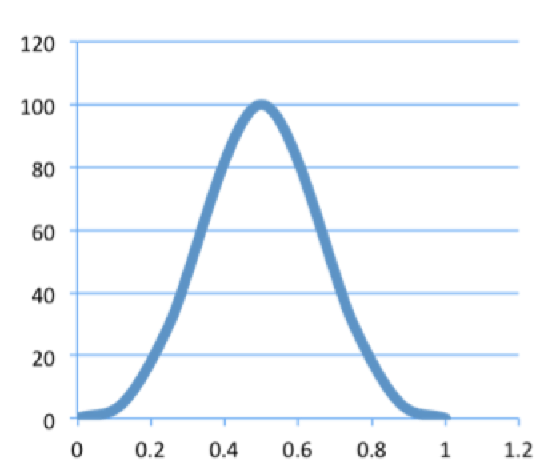



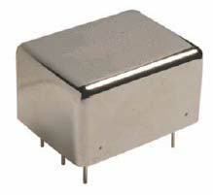



Arista Telemetry for Monitoring & Visibility
LANZ provides real-time congestion management (streaming)
Path Tracer actively monitor of topology-wide health
Flexible hardware enables Tap Aggregation for a cost-effective solution (filtering and manipulation, GUI)
PTP for time accuracy (10ns)
Timestamping in Hardware for Tap Agg or SPAN / monitor traffic
TCPDump of data-plane and control-plane traffic
Splunk forwarder integration, sFlow
VM Tracer rapidly identify virtual connectivity (VM, VXLAN)

Slide 20
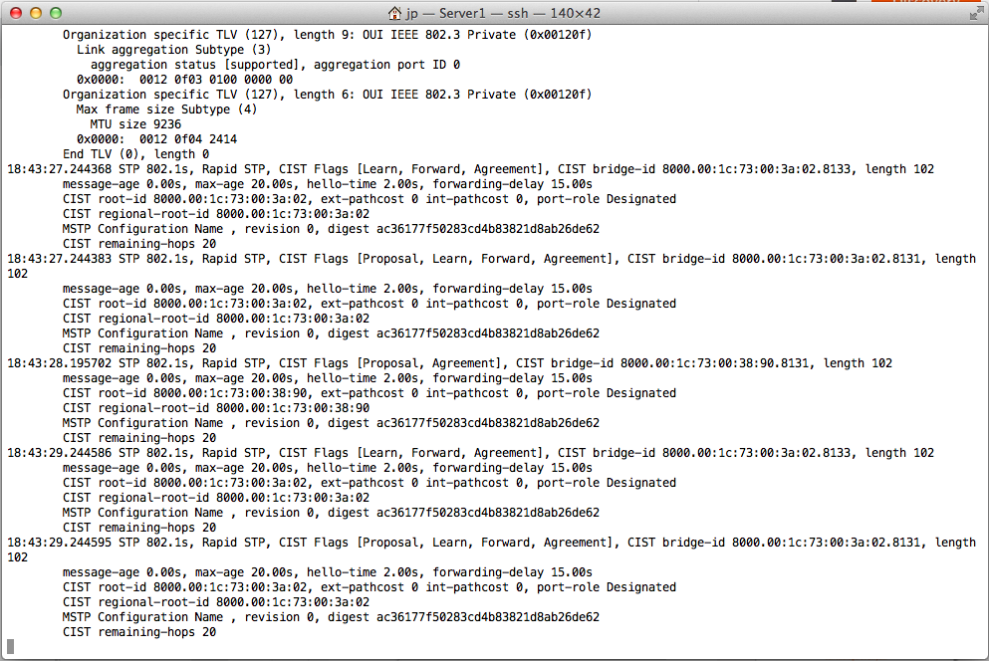
How do we get from this ….

Slide 21
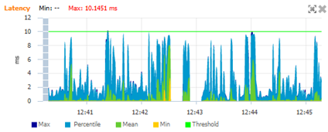
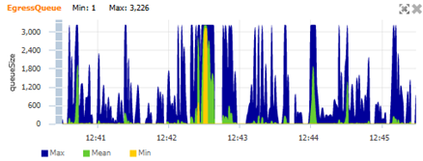
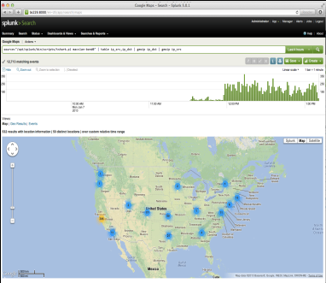
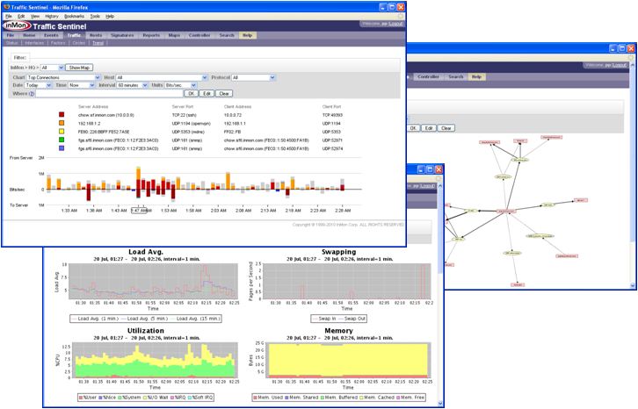
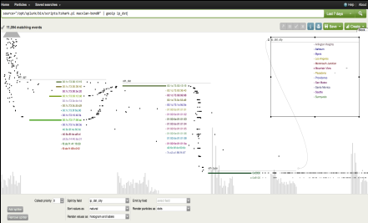
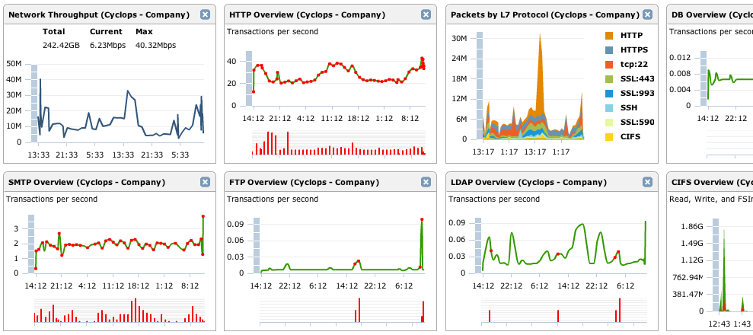
To this ..

Slide 22
Software Defined Networking

Slide 23
Software Defined Networking
Arista Open command API
Programmatic access to all CLI system configuration & status
Response is a structured JSON object
For remote automation/scripting Syntax is sent using JSON-RPC over HTTPS/HTTP
CLI is now built on top of EOS API
API calls can done locally on the switch for scripting based on structured JSON
Response
Request
{
"jsonrpc": "2.0", "method": "runCli“, "params": {
"cmds": [ "show interface Ethernet3“, ],
"format": "json" },
"id": 1
}
{ "jsonrpc": "2.0”, "result": [
{ "Ethernet3" :
{ 'bandwidth': 10000000, 'description': '',
'interfaceStatus': 'up’,
}
}
],
“id”: 1
}
vEOS code available for demonstration and testing

Slide 24

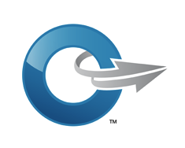
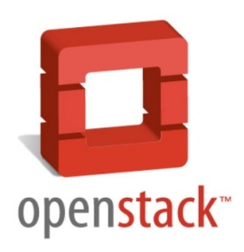
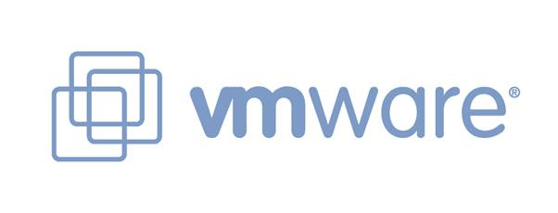






Software Defined Networking
Open to Many Controllers & Programming Models
OpenFlow support with all major controllers
Openstack support. Contribution to Quantum
Network orchestration
Native integration of Vmware vCloud et NSX – VXLAN.
Native integration of Microsoft OMI
Native API instructions developed with key partners, allowing network automation, controlled by applications or services

Slide 25






Arista EOS and Load Balancers
ID | Address | On/ Off
7 | 10.0.0.7 | ☑
6 | 10.0.0.6 | ☑
5 | 10.0.0.5 | ☑
4 | 10.0.0.4 | ☑
3 | 10.0.0.3 | ☑
2 | 10.0.0.2 | ☑
1 | 10.0.0.1 | ☑
☒
☒
☒
VTEP
VNI 5001
VTEP
VNI 5001
10.0.0.0/24
51.51.51.0
Lost Service
Virtualise :
- Network appliances
- Storage
- Servers
VTEP Hardware

Slide 26
Smart System Upgrade: Initiating Maintenance Mode
Maintenance Mode initiated
Snapshot – stores #neighbors, peers, etc
Virtualization
Load Balancer
Network Applications: Smart System Upgrade

Slide 27
Smart System Upgrade: Initiating Maintenance Mode
Maintenance Mode initiated
Snapshot – stores #neighbors, peers, etc
Virtualization
Load Balancer
Directly-connected Vmware hosts put into maintenance mode
Load Balancer VIP Aging enabled via iControl
Network Applications: Smart System Upgrade

Slide 28
Smart System Upgrade: Initiating Maintenance Mode
Maintenance Mode initiated
Snapshot – stores #neighbors, peers, etc
Virtualization
Load Balancer
Directly-connected Vmware hosts put into maintenance mode
Load Balancer VIP Aging enabled via iControl
Open protocols used to drain traffic
Network Applications: Smart System Upgrade

Slide 29
Smart System Upgrade: General Operation
Workload is moved
Overlay facilitates virtual re-cabling
Virtualization
Load Balancer
Network Applications: Smart System Upgrade

Slide 30
Smart System Upgrade: General Operation
Workload is moved
Overlay facilitates virtual re-cabling
Virtualization
Load Balancer
Maintenance is performed on device
Device brought back into service
API calls inform other devices

Slide 31
Smart System Upgrade: General Operation
Workload is moved
Overlay facilitates virtual re-cabling
Virtualization
Load Balancer
Maintenance is performed on device
Device brought back into service
API calls inform other devices
Maintenance summary sent to operations team
Health checks are performed
Removed from maintenance mode
Workloads are rebalanced
Network Applications: Smart System Upgrade

Slide 32
Questions?

