Slide 1
Astronomía con altísima resolución espacial en tiempo real: NEXPReS y e-EVN
Francisco Colomer
Instituto Geográfico Nacional (IGN, M. Fomento)

Slide 2
Índice
Introducción a la radioastronomía y la VLBI
La Red Europea de Interferometría (EVN)
  Instalaciones
  Aplicaciones científicas
El proyecto NEXPReS FP7
  Objetivos
  Desarrollos
  Implementación
Notes:
Two facets:
Facilitating internal communication within the project
Providing tools for project members to share information
External communication
NEXPReS achiev ements and capabilities are communicated to the astronomy community, EVN users and not-yet EVN users, people designing the SKA, networking community that is looking for ways to support science and research in other fields, also general public, funding agencies and science policy makers
Some done directly by the outreach office through press releases, web site, site.
Some is through the tools and materials provided to other working packages , so that when they are giving talks or demos or writing articles, they have visual materials to present a uniform identity for NEXPReS that people recognize and remember, and textual materials that make communication clear and standardized.

Slide 3
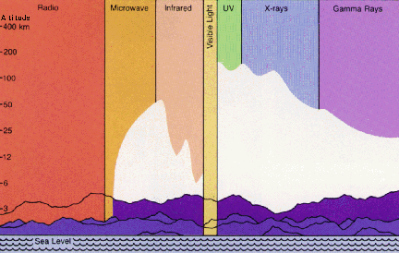
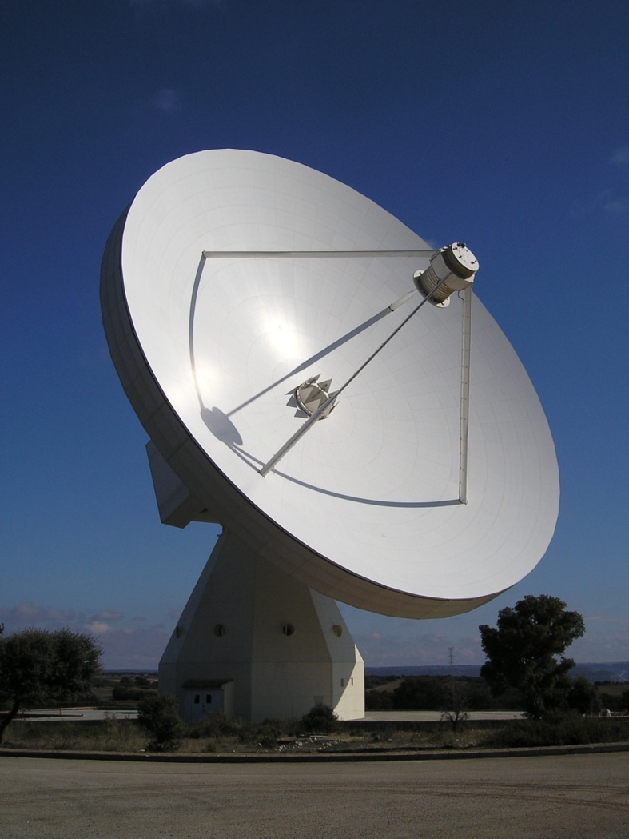
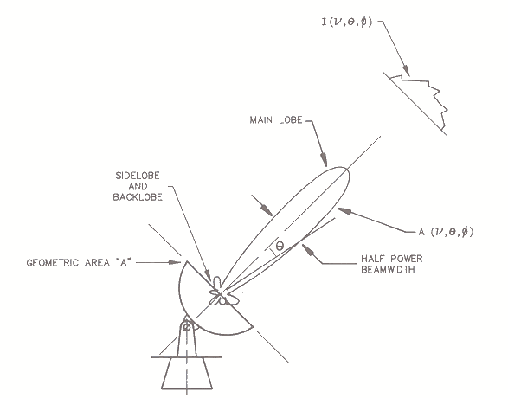
INTRODUCCIÓN
NEXPReS y e-EVN
Radioastronomía
Notes:
This deliverable was due in period 3. The idea was that there would be a scientific capstone meeting for NEXPReS, which would require coordination help. We did have the transients workshop in May, but it was hosted by the Lorentz Center which takes care of all meeting organization and support as part of its hosting services.
And really this deliverable was done on an ongoing basis through the course of the project. The large NEXPReS display and brochures were sent to all appropriate meetings and demos, and the outreach office was central in organizing the EVN display at the International Astronomical Union General Assembly in Beijing last year. This was the first time that the EVN had exhibited at the IAU, and we sent the NEXPReS display and brochures, showed the outreach movie, and it was staffed by young astronomers from Shanghai Astronomical Observatory, which is part of the EVN.

Slide 4
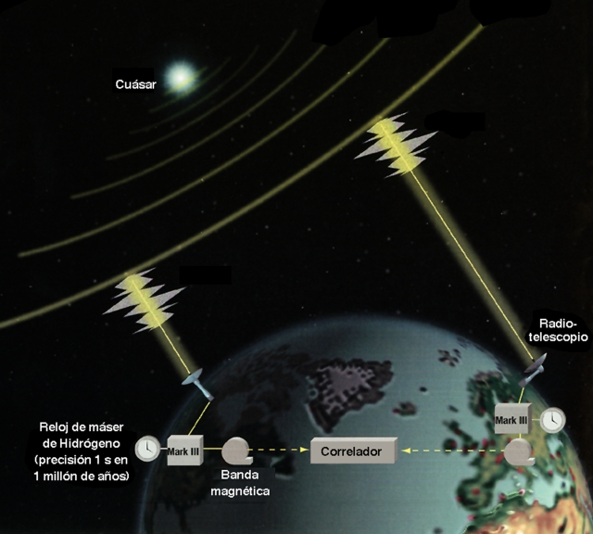
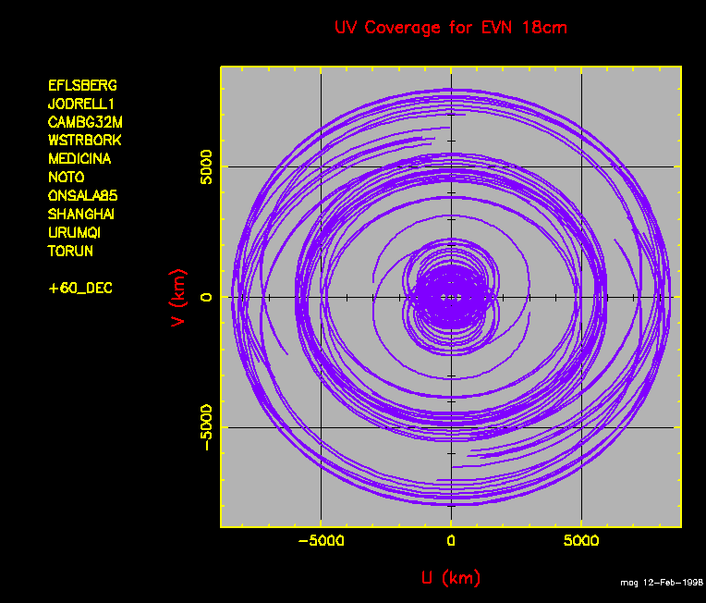
INTRODUCCIÓN
NEXPReS y e-EVN
Interferometría de muy larga base (VLBI)
Notes:
This deliverable was due in period 3. The idea was that there would be a scientific capstone meeting for NEXPReS, which would require coordination help. We did have the transients workshop in May, but it was hosted by the Lorentz Center which takes care of all meeting organization and support as part of its hosting services.
And really this deliverable was done on an ongoing basis through the course of the project. The large NEXPReS display and brochures were sent to all appropriate meetings and demos, and the outreach office was central in organizing the EVN display at the International Astronomical Union General Assembly in Beijing last year. This was the first time that the EVN had exhibited at the IAU, and we sent the NEXPReS display and brochures, showed the outreach movie, and it was staffed by young astronomers from Shanghai Astronomical Observatory, which is part of the EVN.

Slide 5
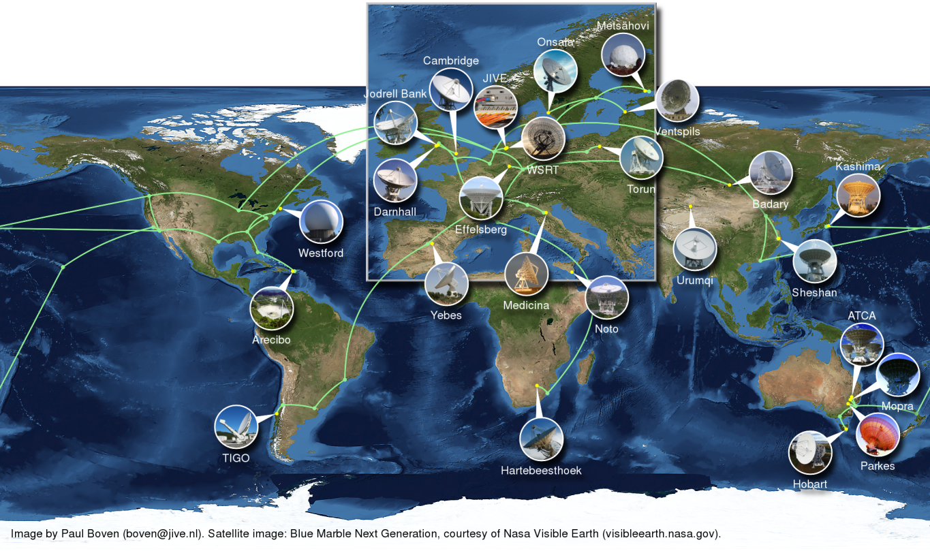
La Red Europea de Interferometría
NEXPReS y e-EVN
European VLBI Network (EVN): 18+ radiotelescopios de 14 institutos, en Europa, China, Sudáfrica, Puerto Rico, Rusia, y otros asociados (e.g. Australia, VLBA en EE.UU., etc.).
Datos transferidos por internet en tiempo-(casi)real: 1 Gbps (habitual) hasta 4-10 Gbps (medio plazo) por telescopio.
Notes:
This deliverable was due in period 3. The idea was that there would be a scientific capstone meeting for NEXPReS, which would require coordination help. We did have the transients workshop in May, but it was hosted by the Lorentz Center which takes care of all meeting organization and support as part of its hosting services.
And really this deliverable was done on an ongoing basis through the course of the project. The large NEXPReS display and brochures were sent to all appropriate meetings and demos, and the outreach office was central in organizing the EVN display at the International Astronomical Union General Assembly in Beijing last year. This was the first time that the EVN had exhibited at the IAU, and we sent the NEXPReS display and brochures, showed the outreach movie, and it was staffed by young astronomers from Shanghai Astronomical Observatory, which is part of the EVN.

Slide 6
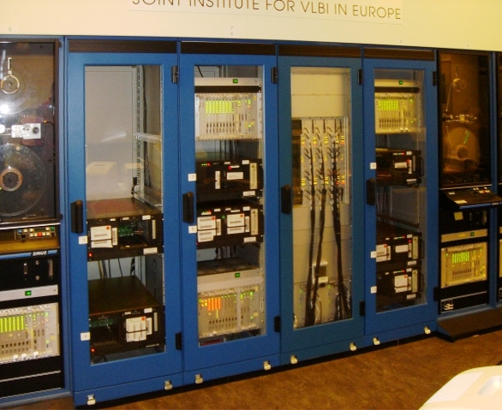
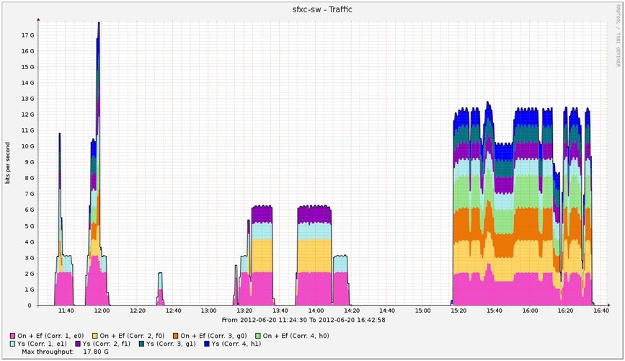
La Red Europea de Interferometría
NEXPReS y e-EVN
Correlación en JIVE, con sede en Dwingeloo (Holanda)
Notes:
This deliverable was due in period 3. The idea was that there would be a scientific capstone meeting for NEXPReS, which would require coordination help. We did have the transients workshop in May, but it was hosted by the Lorentz Center which takes care of all meeting organization and support as part of its hosting services.
And really this deliverable was done on an ongoing basis through the course of the project. The large NEXPReS display and brochures were sent to all appropriate meetings and demos, and the outreach office was central in organizing the EVN display at the International Astronomical Union General Assembly in Beijing last year. This was the first time that the EVN had exhibited at the IAU, and we sent the NEXPReS display and brochures, showed the outreach movie, and it was staffed by young astronomers from Shanghai Astronomical Observatory, which is part of the EVN.

Slide 7
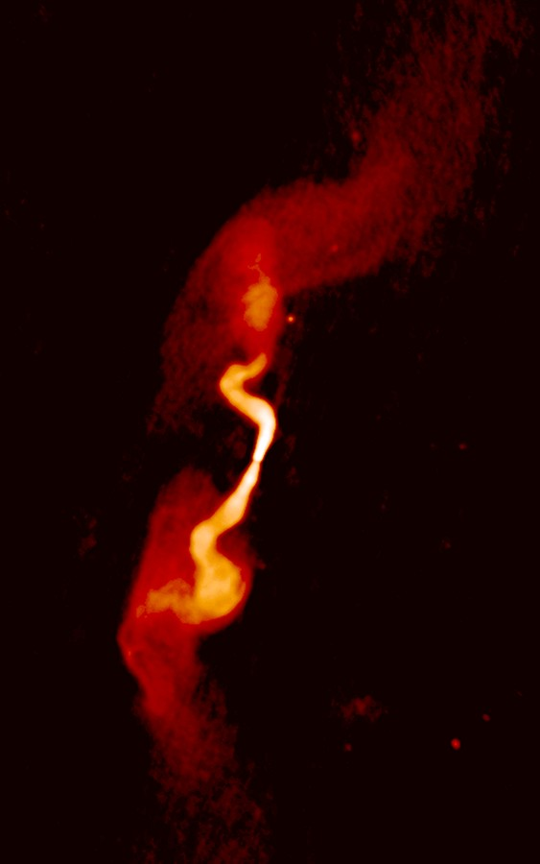
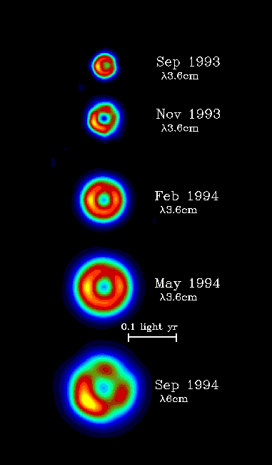
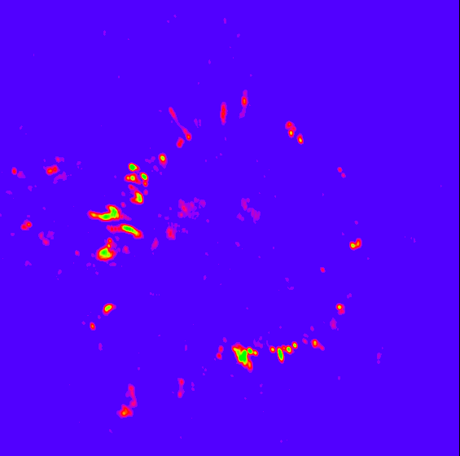
Aplicaciones científicas
NEXPReS y e-EVN
Notes:
This deliverable was due in period 3. The idea was that there would be a scientific capstone meeting for NEXPReS, which would require coordination help. We did have the transients workshop in May, but it was hosted by the Lorentz Center which takes care of all meeting organization and support as part of its hosting services.
And really this deliverable was done on an ongoing basis through the course of the project. The large NEXPReS display and brochures were sent to all appropriate meetings and demos, and the outreach office was central in organizing the EVN display at the International Astronomical Union General Assembly in Beijing last year. This was the first time that the EVN had exhibited at the IAU, and we sent the NEXPReS display and brochures, showed the outreach movie, and it was staffed by young astronomers from Shanghai Astronomical Observatory, which is part of the EVN.

Slide 8
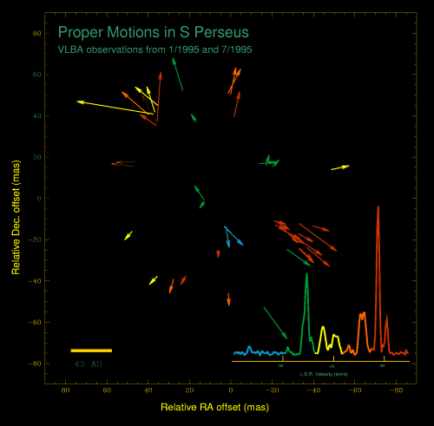
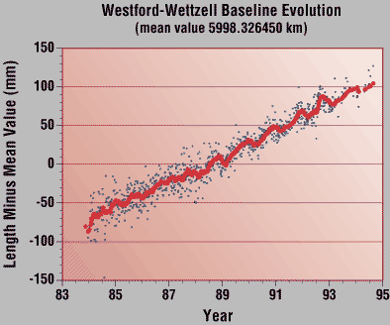
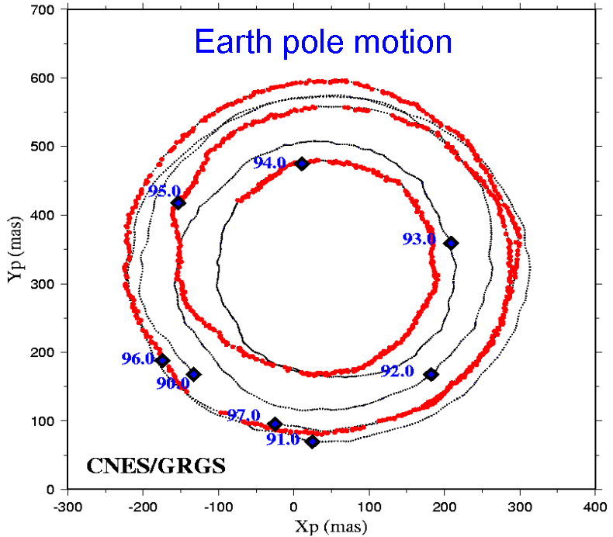
Aplicaciones científicas
NEXPReS y e-EVN
Notes:
This deliverable was due in period 3. The idea was that there would be a scientific capstone meeting for NEXPReS, which would require coordination help. We did have the transients workshop in May, but it was hosted by the Lorentz Center which takes care of all meeting organization and support as part of its hosting services.
And really this deliverable was done on an ongoing basis through the course of the project. The large NEXPReS display and brochures were sent to all appropriate meetings and demos, and the outreach office was central in organizing the EVN display at the International Astronomical Union General Assembly in Beijing last year. This was the first time that the EVN had exhibited at the IAU, and we sent the NEXPReS display and brochures, showed the outreach movie, and it was staffed by young astronomers from Shanghai Astronomical Observatory, which is part of the EVN.

Slide 9
NEXPReS FP7
NEXPReS y e-EVN
Objetivos
  Mejorar la fiabilidad y flexibilidad de la red EVN
  Aumentar la capacidad y calidad científica de la EVN
  Desarrollar hardware y software para gestionar la complejidad
Actividades
  Foro EVN-NREN: colaboran científicos y operadores de las redes nacionales de comunicaciones (e.g. RedIRIS)
  Foro eVSAG: relaciona la Ciencia con la gestión de la EVN
  “Cloud-correlation”
  “Bandwidth on demand”
  “Computing in a shared infrastructure”
  “High-bandwidth, high-capacity networked storage on demand”
Notes:
This deliverable was due in period 3. The idea was that there would be a scientific capstone meeting for NEXPReS, which would require coordination help. We did have the transients workshop in May, but it was hosted by the Lorentz Center which takes care of all meeting organization and support as part of its hosting services.
And really this deliverable was done on an ongoing basis through the course of the project. The large NEXPReS display and brochures were sent to all appropriate meetings and demos, and the outreach office was central in organizing the EVN display at the International Astronomical Union General Assembly in Beijing last year. This was the first time that the EVN had exhibited at the IAU, and we sent the NEXPReS display and brochures, showed the outreach movie, and it was staffed by young astronomers from Shanghai Astronomical Observatory, which is part of the EVN.

Slide 10
NEXPReS FP7
NEXPReS y e-EVN
Foro EVN-NRENs
  Reúne a expertos de la radioastronomía y las comunidades de las redes nacionales de investigación y educación
  identifica otras regiones geográficas de interés para la radioastronomía, aunque insuficientemente conectada en términos de red.
  RedIRIS ha proporcionado fibra oscura para conectividad 10 GE al telescopio de 40m de diámetro del IGN en el Observatorio de Yebes.
Notes:
This deliverable was due in period 3. The idea was that there would be a scientific capstone meeting for NEXPReS, which would require coordination help. We did have the transients workshop in May, but it was hosted by the Lorentz Center which takes care of all meeting organization and support as part of its hosting services.
And really this deliverable was done on an ongoing basis through the course of the project. The large NEXPReS display and brochures were sent to all appropriate meetings and demos, and the outreach office was central in organizing the EVN display at the International Astronomical Union General Assembly in Beijing last year. This was the first time that the EVN had exhibited at the IAU, and we sent the NEXPReS display and brochures, showed the outreach movie, and it was staffed by young astronomers from Shanghai Astronomical Observatory, which is part of the EVN.

Slide 11

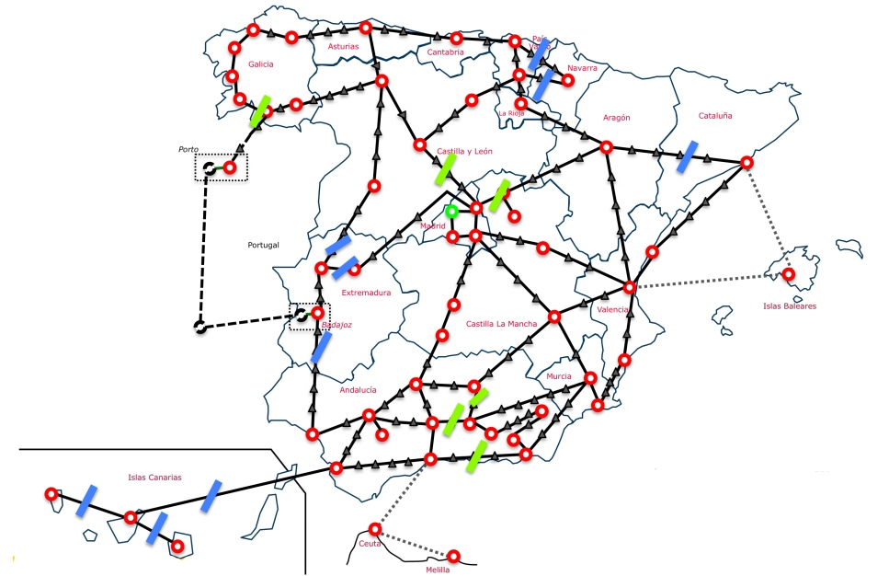
NEXPReS FP7
NEXPReS y e-EVN
Foro EVN-NRENs
Notes:
This deliverable was due in period 3. The idea was that there would be a scientific capstone meeting for NEXPReS, which would require coordination help. We did have the transients workshop in May, but it was hosted by the Lorentz Center which takes care of all meeting organization and support as part of its hosting services.
And really this deliverable was done on an ongoing basis through the course of the project. The large NEXPReS display and brochures were sent to all appropriate meetings and demos, and the outreach office was central in organizing the EVN display at the International Astronomical Union General Assembly in Beijing last year. This was the first time that the EVN had exhibited at the IAU, and we sent the NEXPReS display and brochures, showed the outreach movie, and it was staffed by young astronomers from Shanghai Astronomical Observatory, which is part of the EVN.

Slide 12
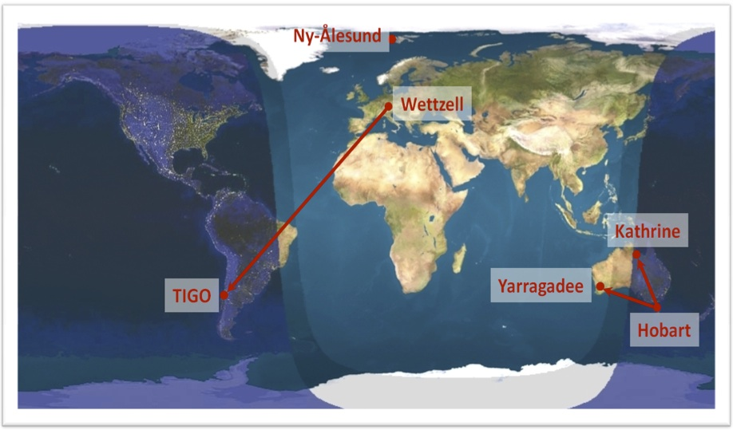
NEXPReS FP7
NEXPReS y e-EVN
“Cloud correlation”
  desarrollo de grabación / transmisión a alta velocidad (>1 Gbps)
  eliminación de la actual distinción entre VLBI basado en disco y e-VLBI (estándar VDIF)
  Control remoto de los observatorios (observaciones y correlación)
Notes:
This deliverable was due in period 3. The idea was that there would be a scientific capstone meeting for NEXPReS, which would require coordination help. We did have the transients workshop in May, but it was hosted by the Lorentz Center which takes care of all meeting organization and support as part of its hosting services.
And really this deliverable was done on an ongoing basis through the course of the project. The large NEXPReS display and brochures were sent to all appropriate meetings and demos, and the outreach office was central in organizing the EVN display at the International Astronomical Union General Assembly in Beijing last year. This was the first time that the EVN had exhibited at the IAU, and we sent the NEXPReS display and brochures, showed the outreach movie, and it was staffed by young astronomers from Shanghai Astronomical Observatory, which is part of the EVN.

Slide 13
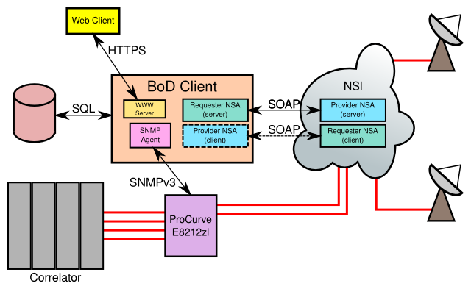
NEXPReS FP7
NEXPReS y e-EVN
“Bandwidth on demand” (BoD)
  Conectividad “bajo demanda”: alentará la adopción de tecnologías de redes dinámicas a escala europea y mundial
  Basado en estándar NIS (“Network Services Infrastructure”)
  Disponible en entorno web (todavía no en España)
Notes:
This deliverable was due in period 3. The idea was that there would be a scientific capstone meeting for NEXPReS, which would require coordination help. We did have the transients workshop in May, but it was hosted by the Lorentz Center which takes care of all meeting organization and support as part of its hosting services.
And really this deliverable was done on an ongoing basis through the course of the project. The large NEXPReS display and brochures were sent to all appropriate meetings and demos, and the outreach office was central in organizing the EVN display at the International Astronomical Union General Assembly in Beijing last year. This was the first time that the EVN had exhibited at the IAU, and we sent the NEXPReS display and brochures, showed the outreach movie, and it was staffed by young astronomers from Shanghai Astronomical Observatory, which is part of the EVN.

Slide 14
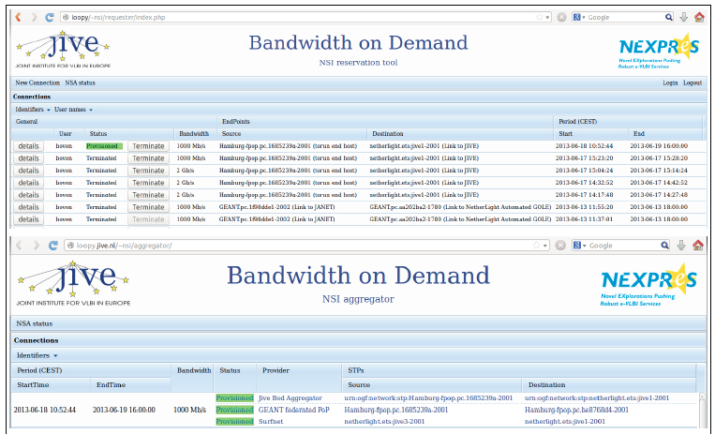
NEXPReS FP7
NEXPReS y e-EVN
Notes:
This deliverable was due in period 3. The idea was that there would be a scientific capstone meeting for NEXPReS, which would require coordination help. We did have the transients workshop in May, but it was hosted by the Lorentz Center which takes care of all meeting organization and support as part of its hosting services.
And really this deliverable was done on an ongoing basis through the course of the project. The large NEXPReS display and brochures were sent to all appropriate meetings and demos, and the outreach office was central in organizing the EVN display at the International Astronomical Union General Assembly in Beijing last year. This was the first time that the EVN had exhibited at the IAU, and we sent the NEXPReS display and brochures, showed the outreach movie, and it was staffed by young astronomers from Shanghai Astronomical Observatory, which is part of the EVN.

Slide 15
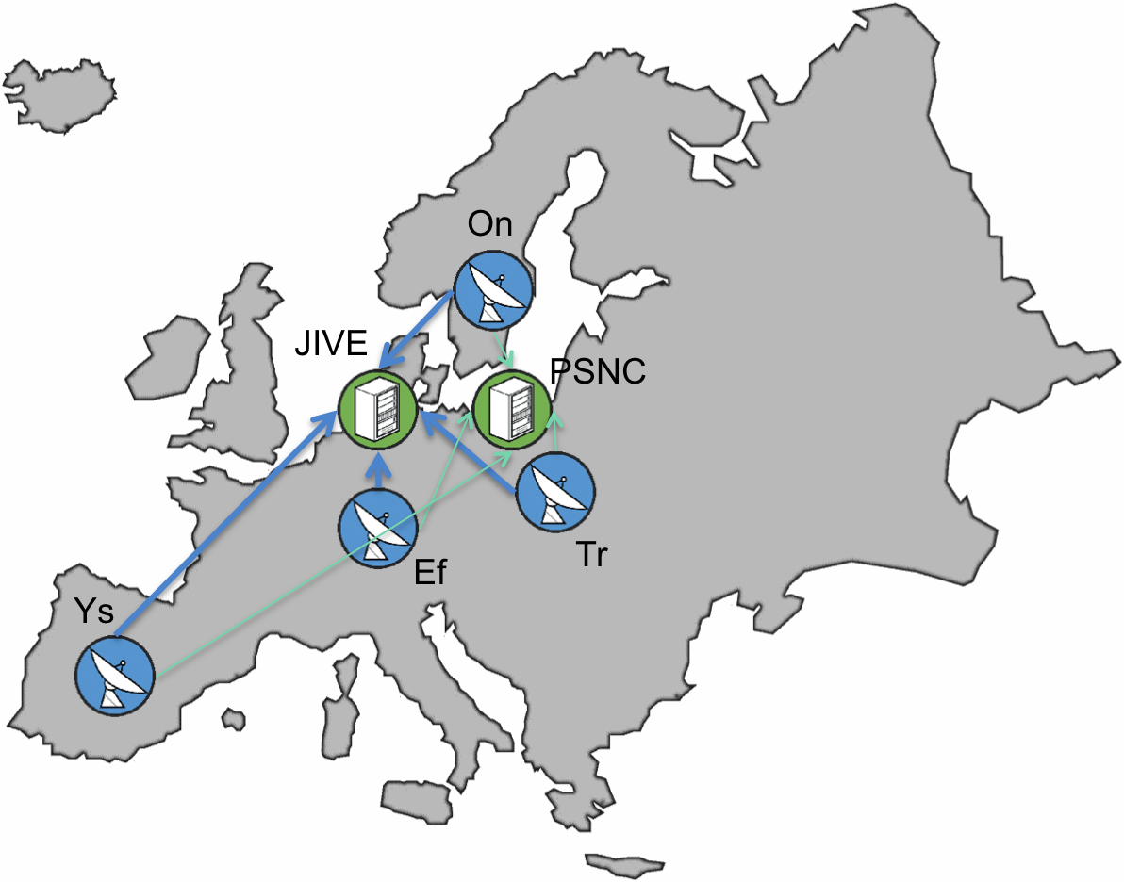
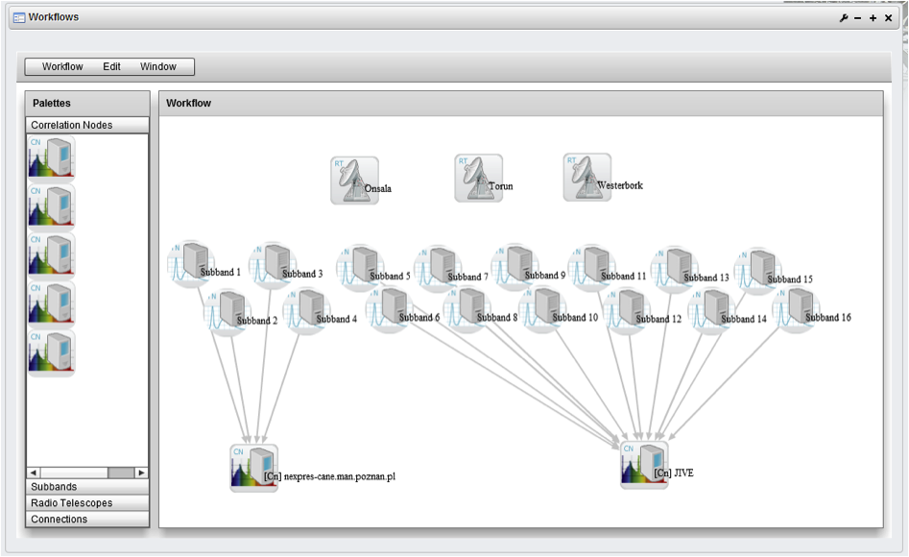
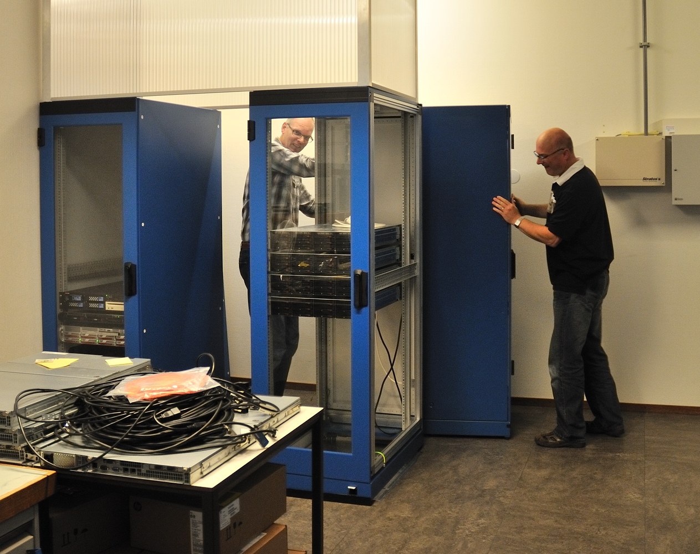
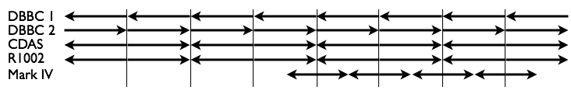
NEXPReS FP7
NEXPReS y e-EVN
“Computing in a shared infrastructure”
  correlación de datos por software (SXFC) distribuida automatizada, y desarrollo de los componentes de una infraestructura en tiempo real que integra recursos de cálculo y de red.
Notes:
This deliverable was due in period 3. The idea was that there would be a scientific capstone meeting for NEXPReS, which would require coordination help. We did have the transients workshop in May, but it was hosted by the Lorentz Center which takes care of all meeting organization and support as part of its hosting services.
And really this deliverable was done on an ongoing basis through the course of the project. The large NEXPReS display and brochures were sent to all appropriate meetings and demos, and the outreach office was central in organizing the EVN display at the International Astronomical Union General Assembly in Beijing last year. This was the first time that the EVN had exhibited at the IAU, and we sent the NEXPReS display and brochures, showed the outreach movie, and it was staffed by young astronomers from Shanghai Astronomical Observatory, which is part of the EVN.

Slide 16
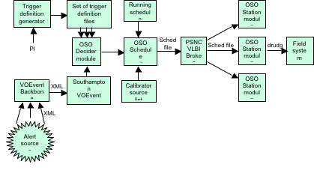
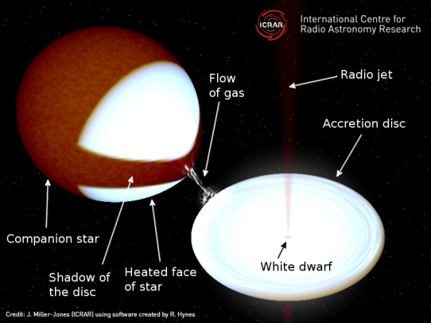
NEXPReS FP7
NEXPReS y e-EVN
“Computing in a shared infrastructure”
  Respuesta automática a eventos impredecibles
http://www.jive.nl/triggered-e-evn-observations-help-pinpoint-puzzling-white-dwarf
Notes:
This deliverable was due in period 3. The idea was that there would be a scientific capstone meeting for NEXPReS, which would require coordination help. We did have the transients workshop in May, but it was hosted by the Lorentz Center which takes care of all meeting organization and support as part of its hosting services.
And really this deliverable was done on an ongoing basis through the course of the project. The large NEXPReS display and brochures were sent to all appropriate meetings and demos, and the outreach office was central in organizing the EVN display at the International Astronomical Union General Assembly in Beijing last year. This was the first time that the EVN had exhibited at the IAU, and we sent the NEXPReS display and brochures, showed the outreach movie, and it was staffed by young astronomers from Shanghai Astronomical Observatory, which is part of the EVN.

Slide 17
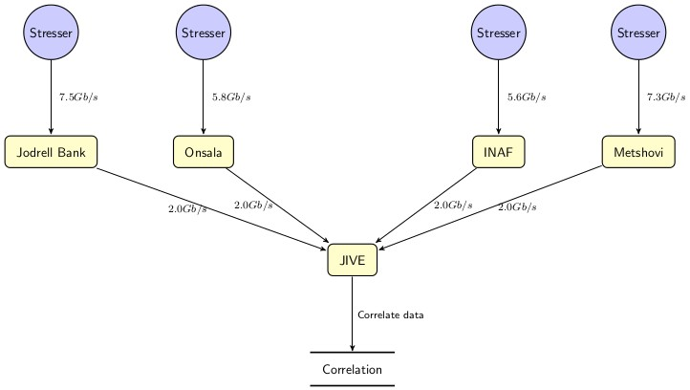
NEXPReS FP7
NEXPReS y e-EVN
“High-bandwidth, high-capacity networked storage on demand”
  implementa almacenamiento distribuido en red para los futuros anchos de banda multi-Gbps / PBps (e.g. SKA)
Notes:
This deliverable was due in period 3. The idea was that there would be a scientific capstone meeting for NEXPReS, which would require coordination help. We did have the transients workshop in May, but it was hosted by the Lorentz Center which takes care of all meeting organization and support as part of its hosting services.
And really this deliverable was done on an ongoing basis through the course of the project. The large NEXPReS display and brochures were sent to all appropriate meetings and demos, and the outreach office was central in organizing the EVN display at the International Astronomical Union General Assembly in Beijing last year. This was the first time that the EVN had exhibited at the IAU, and we sent the NEXPReS display and brochures, showed the outreach movie, and it was staffed by young astronomers from Shanghai Astronomical Observatory, which is part of the EVN.

Slide 18
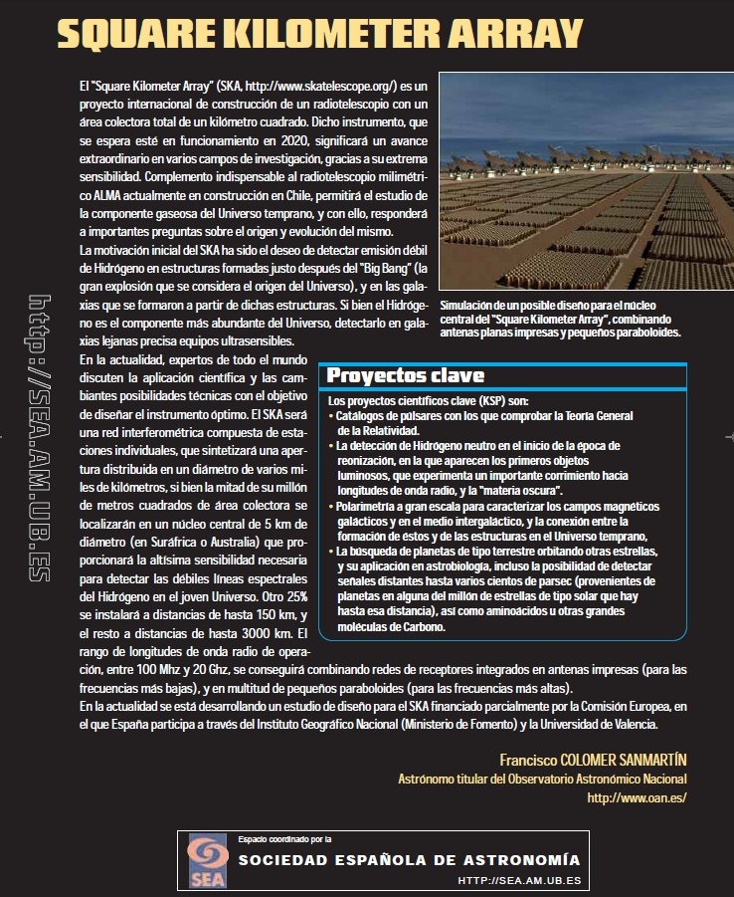
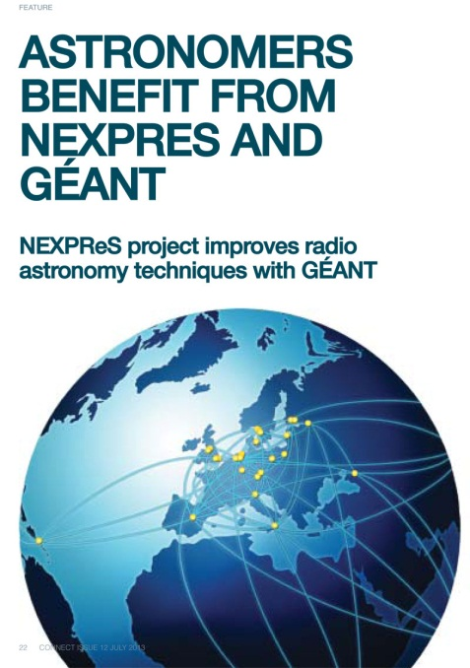
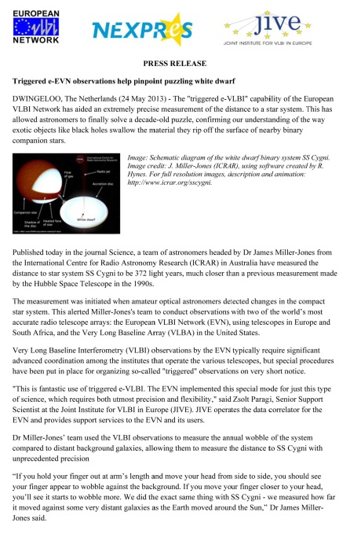
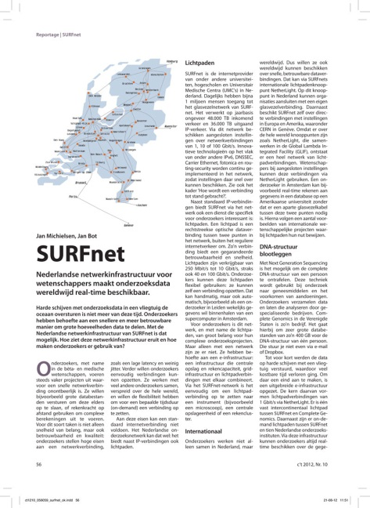
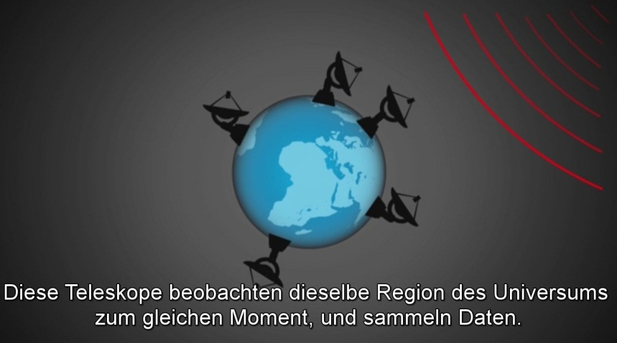
Divulgación
NEXPReS y e-EVN
Prensa, congresos, etc.
Notes:
Meeting Support was the only official deliverable in P3. Other outreach support was provided as needed. For instance SURFnet wrote an article for the Dutch magazine c’t (Computer Techniek), and we helped them with the details of VLBI for that. Also for an item about NEXPReS in GEANT’s CONNECT newsletter.
Also in P3 we translated the outreach movie and set up subtitles in 8 languages.

Slide 19
Conclusiones
NEXPReS y e-EVN
La Red Europea de Interferometría (EVN) es una Gran Instalación Científica Europea que combina en tiempo real los datos recogidos por radiotelescopios, a ritmos de 1 – 10 Gbps por telescopio.
El proyecto NEXPReS FP7 ha desarrollado herramientas para consolidar y ampliar las capacidades de la EVN: correlación en tiempo real por software (SXFC) flexible y distribuida, buffering, rápida respuesta a eventos impredecibles, etc.
El Instituto Geográfico Nacional (IGN) dispone de fibra oscura en el radiotelescopio de 40m de Yebes, gracias a un convenio con RedIRIS y el MINECO.
La colaboración de los NREN (e.g. RedIRIS) es imprescindible para la realización de estudios astronómicos con altísima resolución angular.
Notes:
This deliverable was due in period 3. The idea was that there would be a scientific capstone meeting for NEXPReS, which would require coordination help. We did have the transients workshop in May, but it was hosted by the Lorentz Center which takes care of all meeting organization and support as part of its hosting services.
And really this deliverable was done on an ongoing basis through the course of the project. The large NEXPReS display and brochures were sent to all appropriate meetings and demos, and the outreach office was central in organizing the EVN display at the International Astronomical Union General Assembly in Beijing last year. This was the first time that the EVN had exhibited at the IAU, and we sent the NEXPReS display and brochures, showed the outreach movie, and it was staffed by young astronomers from Shanghai Astronomical Observatory, which is part of the EVN.

Slide 20
Contacto:
Información de contacto:
  Francisco Colomer
  Coordinador Científico-Técnico
  Subdirección General de Astronomía, Geofísica y Aplicaciones Espaciales; Instituto Geográfico Nacional, Ministerio de Fomento.
  Email: f.colomer@oan.es
  Twitter: @PacoColomer
  Más información sobre el proyecto NEXPReS y la e-EVN:
    http://www.nexpres.eu/
    http://www.evlbi.org/
NEXPReS es una Iniciativa de Infrastructuras Integradas (I3), financiada por el 7º Programa Marco de la Unión Europea (FP7/2007-2013) mediante el contrato no RI-261525.
La Red Europea de Interferometría (EVN) es un Consorcio de institutos en Europa, China, Sudáfrica y otros países, financiados por sus propias instituciones nacionales.

