Slide 1


Aplicaciones Móviles en la red Wi-Fi: Nuevas herramientas de visibilidad en un medio invisible cvazquez@arubanetworks.com
Presented by
Aruba Networks
Oct 2013
CONFIDENTIAL © Copyright 2013. Aruba Networks, Inc. All rights reserved

Slide 2
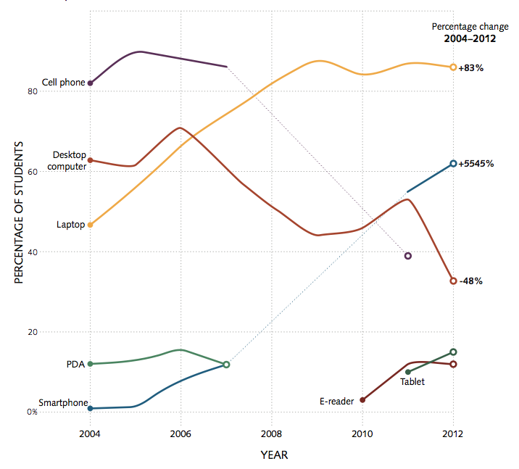
The Wireless Generation
Notes:
The last 8 years has seen staggering changes in the device types on campus. It’s expected that each student has 3-4 mobile devices on them at all times, but also that they will have as many sitting in their residence halls. This is causing huge strain on the network as these devices are staying connected and updating on a regular basis. These devices are also increasing the load on authentication servers as they roam across the corporate network while in use, something you rarely saw with a laptop is now an every day occurrence for thousands of students.

Slide 3
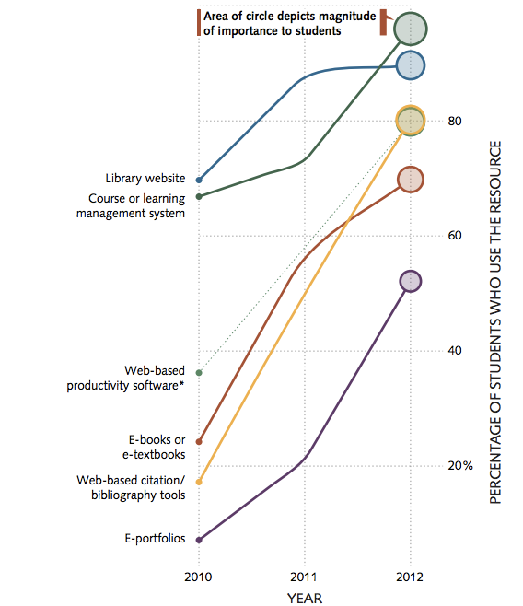



Beyond The Text Book and Blackboard
70% of students used e-books and e-textbooks in 2012
ECAR 2012
Notes:
E-books are also quickly aiming to make the book store obsolete. While the first wave of books is simple a format change from paper to digital, some manufacturers are taking advantage of the medium to include interactive features. This can include books on photography, where you can adjust camera settings in the book and see how it would affect the picture. Other applications are replacing books. A recent book on Jazz allows you to move through a time-line on the history of Jazz, reading and even playing music samples. In some books this content runs locally, while others take advantage of HTML 5 to stream content.
These will all place new demands on the network as loads increase from these “books”, which act more like software and applications every day. They update like software, and students will shift to them for advanced search and note taking features. This means that e-book readers, from kindle to iPad, will be going places where students would have taken a regular book in the past. And the more multifunction the reader, the more they’re going to want connectivity in those locations, indoor or out.

Slide 4




The Campus Today
e-Learning
Multimedia Content
Personal Network Services
Uninterrupted
Operations
Network Capacity
Filtered Access
Notes:
7 years ago Wi-Fi access set your campus apart from those that only provided wire line access. But in it’s basic form Wi-Fi access is now table stakes, everyone expects the campus to have wireless coverage, and those that don’t are seen as being behind the times. New devices are coming, but that also means that new content types are coming to the network, and your students will be looking for coverage that works the way it does in the home. There will be three key contributors in the next few years: blended learning where technology makes it’s way into the classroom increasing the need for uninterrupted network access; Multimedia content pushing up the need for higher levels of capacity and QoS to effectively manage the network; and finally the network needs to support the personall

Slide 5







AppRF™ Technology
Identify the payload
Lync
Skype
BitTorrent
FaceTime
Dropbox
WhatsApp
AirPlay
Adjust RF
Increase Priority
Adjust Priority
Blacklist
Device
Load Balance
Limit Bandwidth
Optimize
Video
Unicast
Bonjour
Notes:
Application Insight
App usage dashboard
Identify URL traffic via DNS resolution
Heuristics and ALGs to fingerprint UC apps
Prioritize business traffic over personal
Wired/wireless/VPN
Results
Identify web services and UC traffic, and prioritize
75% better UC performance
30% more video on iPads
11x faster mobile apps
Multicast Video
Aruba has worked with many universities to enhance video delivery over the WLAN. We have been able to deploy things like HDTV over the WLAN to the residence halls at Liberty University. Aruba has multiple tools for multicast video optimization and delivery, and will work with UVA to ensure the underlying network is also ready to handle the QoS requirements for multicast delivery.
In addition to Aruba’s extensive experience with multicast video, we have made several enhancements to both our products as well as looking at modifying open source codecs. Aruba’s CTO office has an extensive program to make multicast work even better. We look forward to working with UVA to show off the work we’ve been doing and to plan an extensive multicast rollout.

Slide 6
Why WLAN should be App-aware
Application awareness allows optimization of networking stack
Use higher level information to add value at lower levels
Layer 1 adjustments
Pause radio scanning for critical apps
Layer 2 adjustments
Fine grain QoS marking by User and APP
Common voice and video apps are well supported today
SIP, H.323, Vocera, SCCP, etc
Many web apps can also be supported
Layer 7
Layer 6
Layer 5
Layer 4
Layer 3
Layer 2
Layer 1

Slide 7
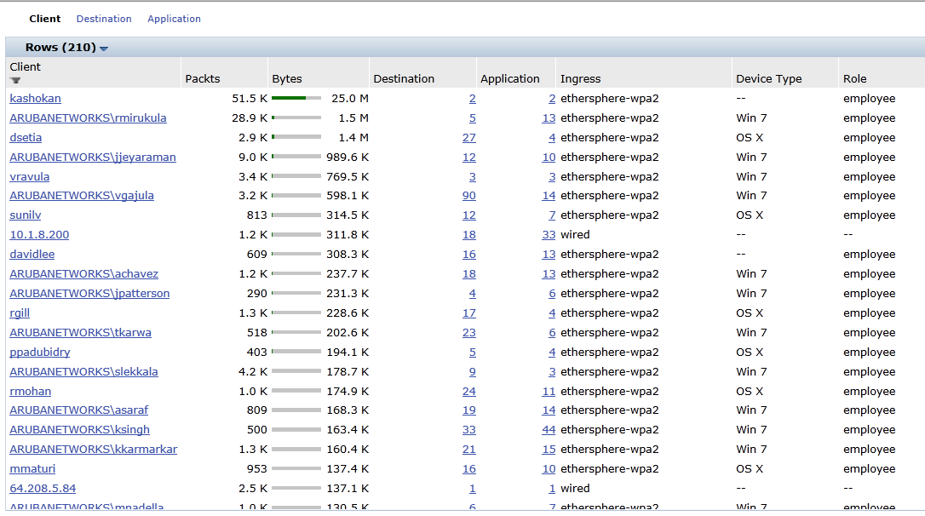
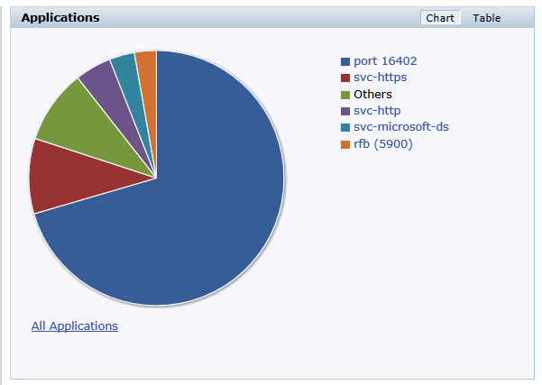
Aruba AppRF Technology
Application Insight
App usage dashboard
Identify URL traffic via DNS resolution
Heuristics and ALGs to fingerprint UC apps
Prioritize business traffic over personal
Wired/wireless/VPN
Results
Identify web services and UC traffic, and prioritize
75% better UC performance
30% more video on iPads
11x faster mobile apps
WebEx
Sharepoint
Supply Chain
Exchange
Oracle
Google
Notes:
Storage testing vs Cisco Aironet 3600 and 5508 WLC for:
www.Box.com www.Dropbox.com www.Amazon.com
www.Google.com

Slide 8
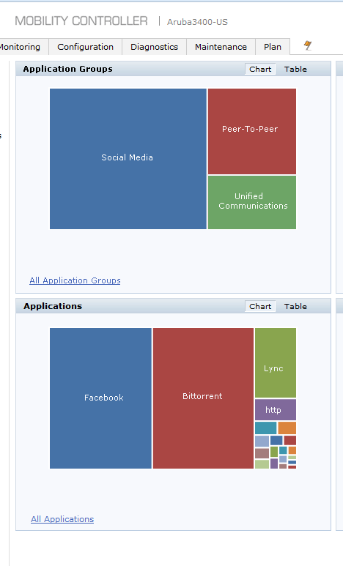
AOS 6.4 - Late 2013 - AppRF 2.0
Incorporates Protocol-Aware Deep Packet Inspection technology
Uses advanced techniques for application ID
Over 1300 Applications
Operates at user role level to provide automated application control
Block application or categories of apps
QoS application at L2 or L3
Bandwidth contracts for applications
New Category Dashboard element
Shows apps by category such as Peer-to-Peer, Streaming video
Graphically based application blocking work flow

Slide 9
What is Protocol-Aware DPI?
Uses protocol grammar analysis
Not just ports, signatures, or heuristics
Much more accurate, identifies more applications
Detects encrypted applications
Decodes traffic inside tunneling protocols
Understands hundreds of protocols and applications and thousands of types of metadata
Distinguish actions launched within an app
such as login, browse, chat, file transfer, etc.
Extracts metadata from app flows
such as message senders and receivers, and names of files shared or attached in an application.

Slide 10
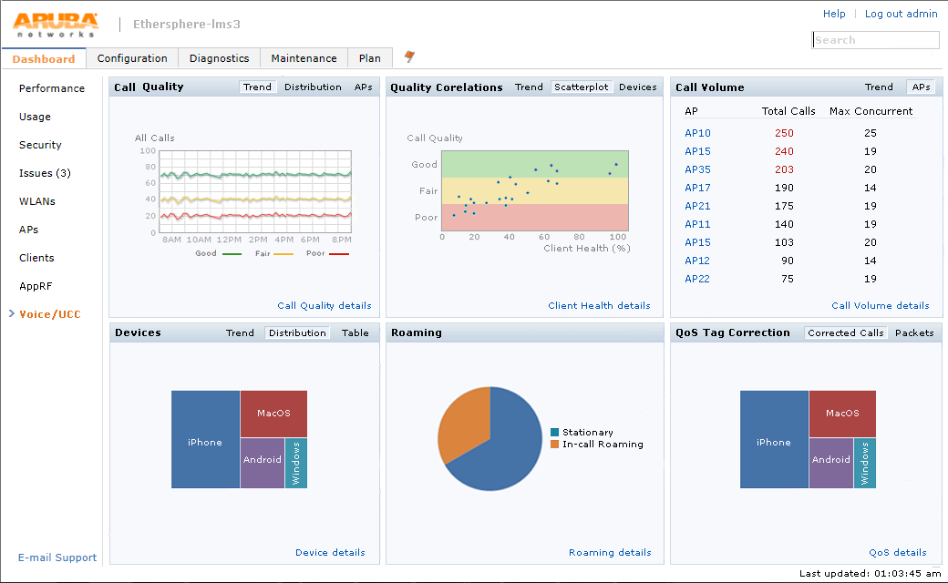
Select the Trend view for Call Volume
DONE

Slide 11
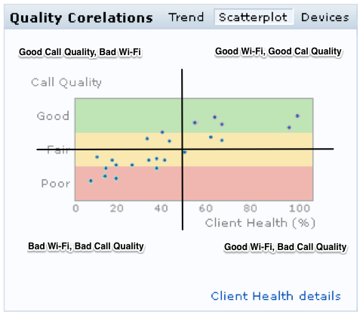
WiFi and Call Health View
Speeds troubleshooting UCC issues
Is it the WiFi, or something else

Slide 12
More Apps – More Traffic

Slide 13

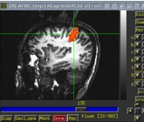

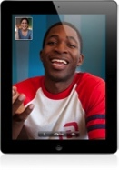



Increasing Network Requirements
Kbps Bandwidth
Required
Full Motion
Video
Imaging
(Docs/Scientific)
Compressed
Video
Unified
Communications
Digital
Audio
VoIP
E-mail
Notes:
As the content begins to be streamed we need to take that into account with our APs, controllers, and network connections. Streaming music to a tablet while viewing images or video all take large amounts of bandwidth. Many tests are now starting to include imagery or video in the test itself. One network we’ve seen recently was streaming HD images of surgery to students in a test for them to comment on, pushing the network hard with 150 students in the same room. All of this will continue to increase the need for faster and faster APs.

Slide 14
2014 is the Year of the AC Client
Wi-Fi chipset forecast for 802.11ac chipsets (millions) source: ABI research
Notes:
11ac clients won’t take over the majority until 2014. Until then, 11n clients will be the majority of devices out there. But as you know when the new school year arrives so will the 11ac capable clients from Apple, Dell, and many others. You should expect your students to be early adopters of the technology. They will likely be buying new 11ac APs for their homes from Apple and other vendors, and will wonder why they aren’t seeing the same speeds and feature sets on your network.

Slide 15


Purpose-built Aruba 220 Series
3x3:3 Dual Radio
5GHz 11ac: up to 1.3Gbps
2.4GHz 11n: up to 450Mbps (600Mbps with Broadcom clients)
2x GE link aggregation
Enabling >1Gbps throughput
Operates with 802.3af, requires 802.3at for full functionality
802.11ac Beamforming
$1,295 US List
Controller-managed & Controllerless**
** Aruba Instant available in Q3 CY2013
Notes:
Aruba’s 802.11ac capable AP220 series Access Points are the first on the market with true gigagit support. With total aggregate capacity of 1.75Gbps, which is well over 1 gigabit, Aruba’s APs are outfitted with dual GigE ports for link aggregation. In addition, the 220 series can be operated with standard 802.3af PoE which is supported by most access layer switches. This means customers can extend the life of their existing wired infrastructure while upgrading to the latest mobility solution without having to make capital investments for wired infrastructure upgrades.
What’s most unique about the AP220 is the ability to exceed 802.11n speeds in the 2.4GHz band. Aruba’s 802.11ac AP supports up to 600Mbps in 2.4 band which is an increase of 150Mbps when used with Broadcom based devices like Apple macbooks, iphones and ipads as well as Samsung galaxy phones.
The 220 series AP will be available both in controller based and controller less versions at a list price of $1295. Lets touch briefly on what we mean by purpose-built

Slide 16
TCP Throughput with 802.11ac
Data Rate
(Mbps)
830
800
600
300
280
240
Smartphone
Laptop
150
95
802.11n
802.11ac
Notes:
As you are probably aware there is always some overhead in wireless transmissions, the numbers above show some typical throughputs for 11n clients, both smartphones and laptops. The difference in throughput is massive as you move from 11n to 11ac, with smartphones practically catching up to 11n laptops. These new speeds will enable whole new classes of applications and deliver options for vendors.

Slide 17







Aruba ClientMatch™
REAL-TIME RF CORRELATION
DEVICE TYPE
LOCATION
CONGESTION
INTERFERENCE
Match to
another AP
Enables use of
802.11ac Wi-Fi rates
98% of mobile devices with higher signal quality
94% better performance for “sticky” clients
88% higher network performance
No client-side software required
Patent: 8,401,554
Notes:
When it comes to performance, there is no match to Aruba’s ClientMatch technology. As you know, there are a variety of different client devices out there running on different operating system, different driver versions, even different capabilities like 802.11 a or b or g or n as well as 11ac. Not all these devices are created equal and just one poorly behaving client can bring down the performance of the whole network. The fundamental issue that on a Wi-Fi network the client device is in control. They make their own decisions on which AP to connect to, how long to stay connected to that AP and when to let go leading to the well known sticky client problem. Problem with this approach is that the Client devices have a narrow view of the network and are generally making decisions that may not be in the best interests of the overall network. ClientMatch fixes this by enabling the Wi-Fi infrastructure to make decisions on behalf of the client while keep a global network wide view in mind.
If you are talking on your cell phone while driving down the road, you are probably going through several different cell towers. As you pass the towers, your active call and your devices is being actively steered by the cell company to the best cell tower for your device. Similarly, ClientMatch enables the infrastructure to steer the devices to the best possible AP based on several different factors like device type, location of the device, signal to noise ratio in the vicinity of the device as well the load on the Access Point. You can see this in action on the animated slide here where the iPad is being steered to another AP. With ClientMatch, the goal is to improve the quality of every single connection which effectively boosts overall network performance providing users with a superior user experience.
As you see on this slide, Aruba has already been granted a patent on this technology making it unique and highly differentiated. Without ClientMatch, an 802.11ac network will operate no different than a 802.11n network and users will not experience much performance gains.
In a real world test, we observed 98% of the devices significant improvement in their Signal to noise ratio when ClientMatch was enabled on the network.

Slide 18

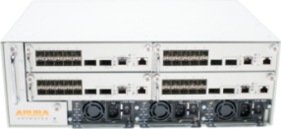
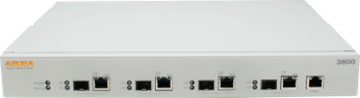
Controller Portfolio
Large Campus
7240
2048 CAP/2048 RAP
32K Users
40 Gbps Firewall
7210
512 CAP/512 RAP
16K Users
20 Gbps Firewall
7220
1024 CAP/1024 RAP
24K Users
40 Gbps Firewall
Scale
Satellite Campus
M3
512 CAP/1024 RAP
8K Users
20 Gbps Firewall
3600
128CAP/512 RAP
8K Users
4 Gbps Firewall
3400
64 CAP/256 RAP
4KUsers
4 Gbps Firewall
3200
32 CAP/128 RAP
2K Users
3 Gbps Firewall
Performance
Notes:
With Aruba’s new line of controllers, the 7200 series, we make it very easy to build larger mobility domains. With up to 2048 APs in a single mobility domain we limit the number of times a device has to re-authenticate with the network. We also have the scale to handle all of the devices that your students want to throw at us, with capacity for up to 32000 devices on a single controller and 40 Gbps of throughput. Campuses such as the University of San Diego in Southern California are running over 1800 APs across their campus on a redundant pair of 7240s, covering their campus and even their new baseball stadium.

Slide 19
Apps defined by the Network: SDN

Slide 20


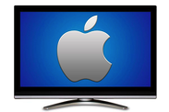






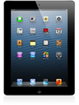


New Apps across Wired & Wireless
Experience
Tools
Data
How do I connect AirPlay?
How do I prioritize video?
Meeting Room Apple TV
Meeting Room
Lync Client
Lync
Mobile
Guest iPad
Notes:
Flow based networking in both wired + wireless access: Lync example and AirGroup example

Slide 21




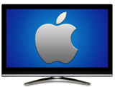

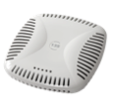

Example: Context-based AirPlay (L2)
ClearPass shares user, role and location specific access rules
2
Discovers Apple TVs across wired & Wi-Fi
1
Experience
Tools
mDNS proxy responds with a list of available Apple TVs
6
AirPlay streaming across VLANs
4
Data
mDNS request to find an Apple TV
3
Multicast frames converted unicast to save airtime
5

Slide 22
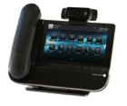

Example: Alcatel OpenTouch (L4-7)
OpenTouch initiates the call setup
2
5
Mobility Controller instructs flows at the access layer
Experience
Tools
Mobility Controller validates session setup
4
Mobility Controller inspects app-in-app (voice call)
Data
3
OmniSwitch
tags QoS downstream
6
8
OpenTouch client tags QoS upstream
OmniSwitch
sets up flows
7
1
Smartphone starts UC session

Slide 23
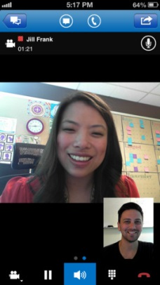





Next Generation Design: Hybrid Flow Based Architecture
Application Services
AirGroup
VoIP
LBS
User Management
AAA
Mobility
Aruba SDN Controller
Aruba Network OS
Flow Plumbing
Flow Plumbing
Mobility Core
AppRF DPI for Flow Classification
Core Network
OF
OF
OF
OF
OF
Access Switch
Access Points

Slide 24


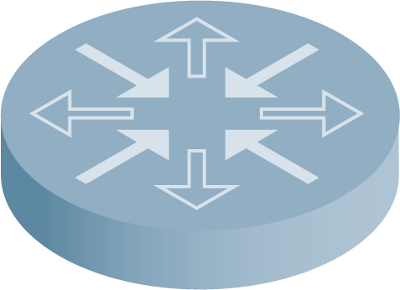


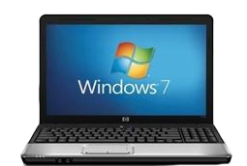
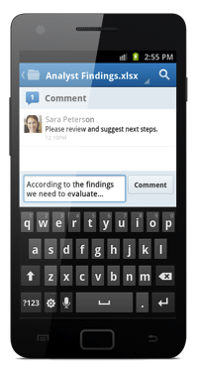
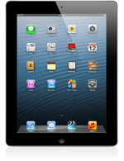
Real life Example: Arista HQ
Virtual cut-through paths per user/app
Unified access on multi-vendor access
OF
Aruba SDN Control Plane
OpenFlow Vendor Core
OF
OF
OF
OF
OF
OF
OF
OF
OF
OF
OF
OF

Slide 25
Control Apps on Devices

Slide 26



Application Control Separates Corporate and Personal Data
Under
MDM
Private to Employee
Corporate Controlled
Corporate
Apps
Personal
Apps

Slide 27

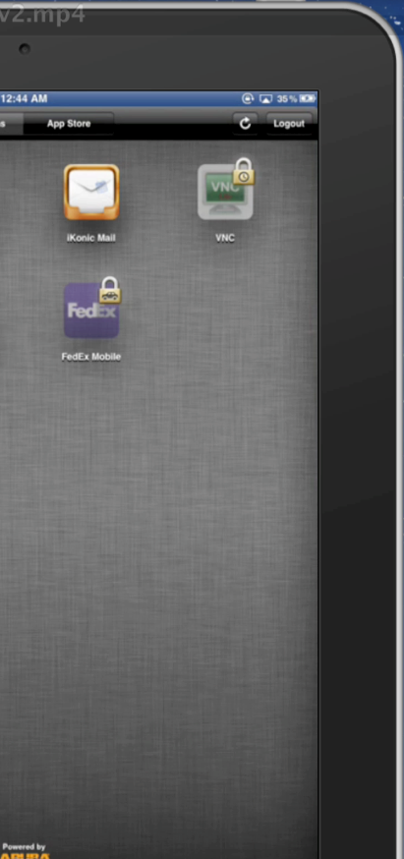











Control Apps Based on Context
Mobile Context
TIME-FENCING
Point of Sale App:
Must be used during store hours
GEO- FENCING
EMR Apps:
Must be used at hospital or member facilities
MOTION
SENSING
Email App:
Can not be used while driving/moving
CONTENT
CONTROL
Browser App:
Can not access torrent sites
DEVICE CONTROL
Device Status:
Cut & paste restrictions, Jailbreak / Root detection, Cloud backup

Slide 28




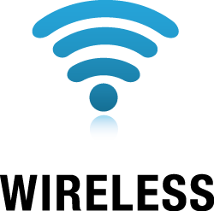





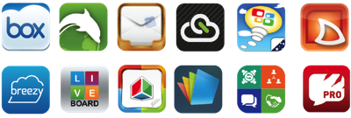
ClearPass: Single Policy Management System
WHO
WHAT
WHEN
WHERE
HOW
NETWORK ACCESS
MANAGEMENT
DEVICE ONBOARDING
AND MANAGEMENT
MOBILE APP
MANAGEMENT
On Any Network
Faster Device Deployments
Massive App
Ecosystem
Hardware or Virtual Appliance

Slide 29
Aruba and EDU

Slide 30

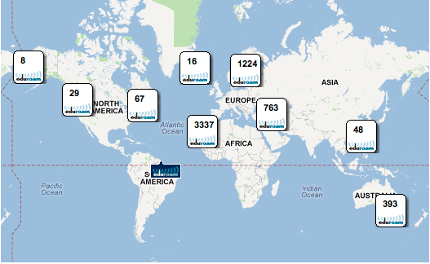
Eduroam
Notes:
At Aruba we are always looking at ways to partner with education to bring the latest technologies to market. One of these is the Eduroam network. This federation of schools allows seamless roaming across member schools. When you are on an Eduroam campus your wireless devices connect just like they would at your home campus. In fact your authentication credentials are securely sent to your home campus. This makes it easier for students and faculty to visit other schools, and eliminates the needs to provide them with special guest access. Our ClearPass authentication gateway even includes a pre-configured plug-in to work with Eduroam, easing the burden of configuration and setup.

Slide 31













Aruba’s Community of SMEs
Certifications & MVP
Practical, Not Academic
ACMA
ACMP
ACMX
ACDX
CCxx
MCxx
CWxx
ACSP
AWMP
AIRWAVE
CLEARPASS
Airheads Social
Home of the Mobility Experts
Airheads Local
Regional Training Days
since 2011
Airheads Conference
A week on all things mobility

Slide 32
Thank You

