Slide 1

Juniper networks
Nueva Estrategia de Seguridad frente a los Ciberataques
José Fidel Tomás – fidel.tomas@juniper.net

Slide 2











2-3-7: Juniper’s business strategy
2 Customer Segments
3 Businesses
Service Provider
Enterprise
Routing
Edge
Datacenter
WAN
Switching
7 Domains
Security
Core
Access & Aggregation
Campus & Branch
Consumer & Business Device

Slide 3





Executing on the strategy
Users
Data Centers
Security Intelligence
Client
Web Security
Application Visibility
Internal Attack Protection
Intrusion Deception
Content
Security
IPS
Network Security
Firewall
Security Management

Slide 4
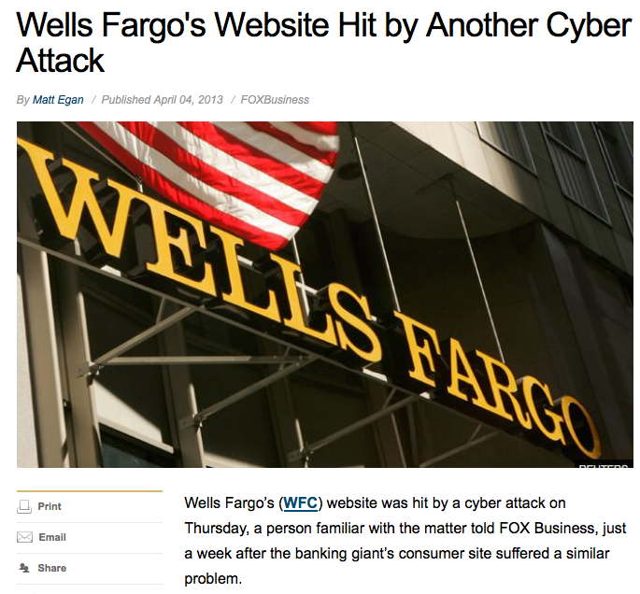
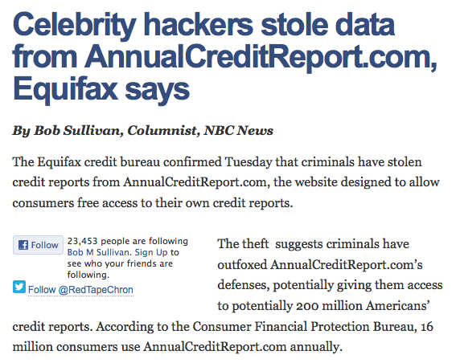
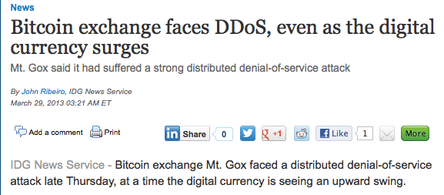
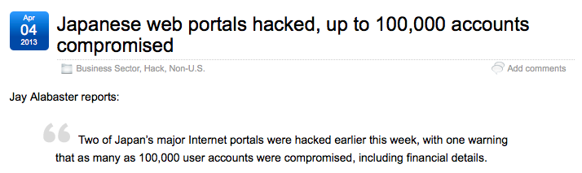
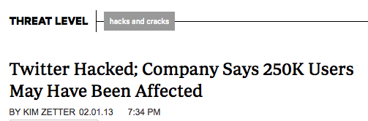
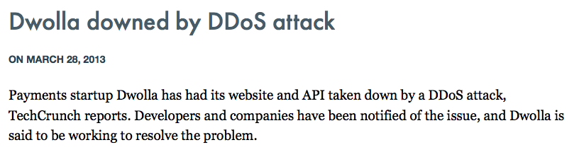
Datacenter security has unique challenges
NextGen Firewall Has Little Relvance
DDoS Threatens Availability
Hacking Targets Valuable Data
Critical Data
DDoS-related downtime has doubled in 2013
54% of large orgs hacked via insecure Web apps

Slide 5
The customer Problem
73%
53%
60%
Of security professionals say current next-generation solutions don’t address the problem
Companies hacked through web applications in past 24 months
Of attacks were external, targeting the data center
Signature and IP/reputation blocking are inadequate
Web application security solutions not solving the problem
Continued DDoS attacks at scale not being stopped
No intelligence sharing
Ongoing confusion around securing virtual infrastructure
Sources: KRC Research and Juniper Mobile Threat Center

Slide 6


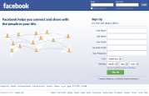


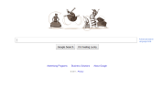

Hacker threats
Scripts & Tool Exploits
IP Scan
Targeted Scan
Generic scripts and tools against one site.
Script run against multiple sites seeking a specific vulnerability.
Targets a specific site for any vulnerability.
Botnet
Human Hacker
Script loaded onto a bot network to carry out attack.
Sophisticated, targeted attack (APT). Low and slow to avoid detection.
Jan
June
Dec

Slide 7
The Cost of an Attack Ponemon Institute | Average breach costs $214 per record stolen
Sony Stolen Records 100M
Theft
Reputation
Revenue
Sony Lawsuits $1-2B
Sony Direct Costs $171M
23 day network closure
Lost customers
Security improvements
Notes:
http://mashable.com/2011/05/22/psn-costs-infographic/

Slide 8


Web App Security Technology
Web Application Firewall
Web Intrusion Deception System
Detection | Signatures | ✓ | ✓
 | Tar Traps |  | ✓
Tracking | IP address | ✓ | ✓
 | Browser, software and scripts |  | ✓
Profiling | IP address | ✓ | ✓
 | Browser, software and scripts |  | ✓
Responses | Block IP | ✓ | ✓
 | Block, warn and deceive attacker |  | ✓
PCI | Section 6.6 | ✓ | ✓

Slide 9



The Junos WebApp Secure advantage Deception-based Security
Detect
Track
Profile
Respond
“Tar Traps” detect threats without false positives.
Track IPs, browsers, software and scripts.
Understand attacker’s capabilities and intents.
Adaptive responses, including block, warn and deceive.

Slide 10






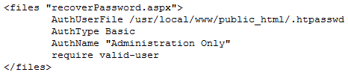
Detection by Deception
Tar Traps
Query String Parameters
Network Perimeter
Hidden Input Fields
Client
Firewall
App Server
Database
Server Configuration

Slide 11


Track Attackers Beyond the IP
Track IP Address
Track Browser Attacks
Persistent Token Capacity to persist in all browsers including various privacy control features.
Track Software and Script Attacks Fingerprinting HTTP communications.

Slide 12



Junos Spotlight Secure
Junos Spotlight Secure
Global Attacker Intelligence Service
Attacker fingerprint uploaded
Attacker fingerprint available for all sites protected by Junos WebApp Secure
Junos WebApp Secure protected site in UK
Attacker from San Francisco
Detect Anywhere, Stop Everywhere
Notes:
Launched in April 2013.
The first global attacker intelligence service.
Attackers who attack a website protected by Junos Web App Secure are detected using deception.
Their fingerprint is captured and shared up to a cloud service – Junos Spotlight Secure.
The fingerprint is made up of over 200 attributes of the attackers device, including IP address, plugins, fonts and languages.
The fingerprint is now available for any website protected by Junos WebApp Secure. A subscription to Junos Spotlight Secure gives you protection from attackers who haven’t been to your site yet.

Slide 13

Fingerprint of An Attacker
Browser version
200+
attributes used to create the fingerprint.
Timezone
Fonts
~ Real Time
availability of fingerprints
Browser add-ons
False Positives
IP Address
nearly zero

Slide 14
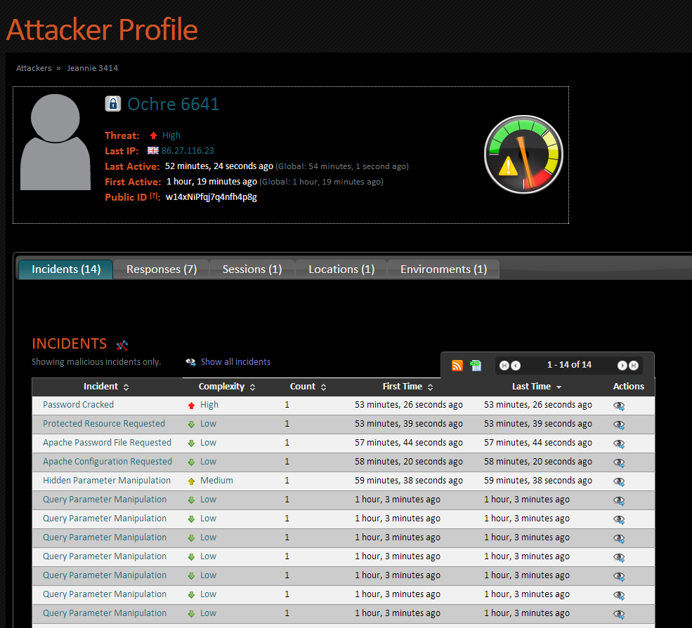
Smart Profile of Attacker
Attacker local name (on machine)
Attacker global name
(in Spotlight)
Attacker threat level
Incident history

Slide 15
Respond and Deceive
Junos WebApp Secure Responses | Human Hacker | Botnet | Targeted Scan | IP Scan | Scripts &Tools Exploits
Warn attacker | ●
Block user | ● | ● | ● | ● | ●
Force CAPTCHA | ● | ● | ● | ● | ●
Slow connection | ● | ● | ● | ● | ●
Simulate broken application | ● | ● | ● | ● | ●
Force log-out | ● | ● |  |  | ●
All responses are available for any type of threat. Highlighted responses are most appropriate for each type of threat.

Slide 16
Datacenter security has unique challenges
NextGen Firewall Has Little Relvance
DDoS Threatens Availability
Hacking Targets Valuable Data
Critical Data
DDoS-related downtime has doubled in 2013
54% of large orgs hacked via insecure Web apps

Slide 17

JUNOS DDoS SECURE
The most advanced heuristic DDoS technology

Slide 18
JUNOS DDoS SECURE - Our credentials
Established in 2000 - Since day1 DDoS detection & mitigation has been our exclusive focus.
We sold the worlds very first DDoS solution in July 2000
The technology is the most advanced in the market.
It is low touch, high tech. The heuristic design means it learns from and dynamically responds to each and every packet.
Its proven in some of the worlds most demanding customer environments and today our technology is trusted to protect in excess of $60 billion of turnover.

Slide 19
JUNOS DDoS SECURE Variants
VMware Instance good for 1Gb throughput
1U appliance capable of between 1Gb & 10Gb
10U blade appliance capable of 20 to 40Gb
1U appliances have a choice of Fail-safe Card
Fiber (1G SX/LX 10G SR/LR)
Copper (10M/100M/1G)
All can be used Stand Alone or as Active – Standby Pair
Or Active – Active (Asymmetric Routing)

Slide 20
JUNOS DDoS SECURE How does it work
Packet validated against pre-defined RFC filters
Malformed and mis-sequenced packets dropped
Individual IP addresses assigned CHARM value
Value assigned based on IP behaviours
Mechanistic Traffic
Low CHARM Value
First Time Traffic
Medium CHARM Value
Humanistic, Trusted Traffic
High CHARM Value

Slide 21

JUNOS DDoS SECURE How does it work
CHARM Algorithm
Access dependent on CHARM threshold of target resource
Below threshold packets dropped
Above threshold allowed uninterrupted access
Minimal (if any) false positives
CHARM threshold changes dynamically with resource ‘busyness’
Full stateful engine measures response times
No server Agents

Slide 22
JUNOS DDoS SECURE PACKET flow sequence
CHARM TechnologyResource Control
IP Behavior Table
Resource CHARM Threshold
Validates data packet
Validates against defined filters
Validates packet against RFCs
Validates packet sequencing
TCP Connection state
Behaviour is recorded
Supports up to 32-64M profiles
Profiles aged on least used basis
Calculates CHARM Threshold
Responsiveness of Resource
1
3
4
Packet Enters
Syntax Screener
OK So Far
CHARM Generator
With CHARM Value
CHARM Screener
Packet Exits
Calculates CHARM value for data packet
References IP behaviour table
Function of time and historical behaviour
Better behaved = better CHARM
Allow or Drop
CHARM Threshold
CHARM value
2
5
Drop Packet
Drop Packet

Slide 23
JUNOS DDoS SECURE resource management
Resource Control
In this example, Resource 2’s response time starts to degrade and the CHARM pass threshold is increased to start the process of rate limiting the bad traffic. At this point the good traffic will continue to pass unhindered whilst the attackers will start to believe their attack has been successful as their request fails.
The attack traffic to Resource 2 reduces as the attackers switch the attack to Resource 3.
Once again, Junos DDoS Secure responds dynamically by increasing the pass threshold for Resource 3miting bad traffic.
Resource 1
Resource 2
Resource 3
Resource ‘N’

Slide 24
Heuristic Mitigation in action
Normal Internet Traffic
Normal Internet Traffic
DDoS Attack Traffic
Resources
Normal Internet Traffic
Junos DDoS Secure Heurisitc Analysis
DDoS Attack Traffic
Management PC
Normal Internet traffic flows through the Junos DDoS Secure Appliance, while the software analyses the type, origin, flow, data rate, sequencing, style and protocol being utilised by all inbound and outbound traffic. The analysis is heuristic in nature and adjusts over time but is applied in real time, with minimal (store and forward) latency.

Slide 25
JUNOS DDoS SECURE summary
Defined
Outstanding 24/7 support
80% Effective 10 mins after installation
99.999% effective after 6-12 hours
Virtualized options available
Dynamic Heuristic Technology
Multi Tenanted and fully IPv6 compliant
1Gb to 40Gb HA appliances
No Public IP address
Layer 2 Transport Bridge

Slide 26

Juniper SECURITY
Juniper’s Spotlight Secure global attacker database is a one-of-a-kind, cloud-based security solution that identifies specific attackers and delivers that intelligence to Junos security products
WebApp
Secure
DDoS
Secure
Spotlight Attacker Database
WebApp Secure
Spotlight Attacker Database
DDoS Secure
SRX
Secure
SRX Secure

Slide 27
Juniper SECURITY
Spotlight Attacker Database
WebApp
Secure
DDoS
Secure
What it is
Aggregates hacker profile information from global sources in a cloud-based database
Distributes aggregated hacker profile information to global subscribers
Why it’s different
High accuracy zero day attacker detection and threat mitigation
Only solution to offer device-level hacker profiling service
Can block a single device/attacker
Spotlight Attacker Database
WebApp Secure
SRX
Secure
DDoS Secure
SRX Secure

Slide 28
Juniper SECURITY
Spotlight Attacker Database
WebApp
Secure
DDoS
Secure
WebApp Secure
What it is
Continuously monitors web apps to stop hackers and botnets
Collects forensic data on hacker device, location, and methods
Continuously updates on-board hacker profile information
Why it’s different
Accurate threat mitigation with near-zero false positives
Hacker profile sharing for global protection surface
Flexible deployment (i.e., appliance, VM, AWS)
Spotlight Attacker Database
SRX
Secure
DDoS Secure
SRX Secure

Slide 29
Juniper SECURITY
Spotlight Attacker Database
WebApp
Secure
DDoS
Secure
WebApp Secure
DDoS Secure
What it is
Large-scale DDoS attack mitigation
Slow and low DDoS attack mitigation
Zero-day protection via combination of behavioral and rules-based detection
Why it’s different
Broadest protection with deployment ease
Industry leading performance – 40Gb throughput
Ease of use through automated updating
Flexible deployment (i.e., 1U appliance, VM)
Spotlight Attacker Database
SRX
Secure
SRX Secure

Slide 30
Juniper SECURITY
Spotlight Attacker Database
WebApp
Secure
DDoS
Secure
WebApp Secure
DDoS Secure
SRX Secure
What it is
Provides network security services
WebApp Secure communicates attacker information to SRX upon detection of attempted breach
SRX uses WebApp Secure intelligence about ongoing attack to block offending IP(s)
Why it’s different
Only security provider to leverage hacker profile intelligence in network firewalling
Provides large-scale web attack mitigation and web DDoS prevention
Extends existing SRX capabilities with web DDoS mitigation
Spotlight Attacker Database
SRX
Secure

Slide 31
Notes:
31

